Slide 1
Science 9- Ecology
Notes:
NOTE: To change images on this slide, select a picture and delete it. Then click the Insert Picture icon
in the placeholder to insert your own image.

Slide 2
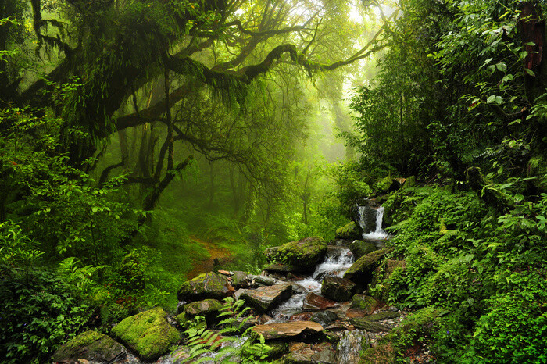
Biotic & Abiotic Influences
Ecosystem: all the living organisms that share a region & their physical & chemical environment
Examples: Pond, Forest, Tide pool …
Sustainable Ecosystem: an ecosystem that is maintained through natural processes
Sustainability: the ability to maintain natural ecological conditions without interruption or weakening

Slide 3
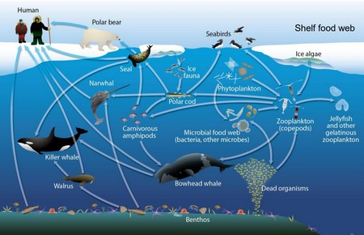
Biotic & Abiotic Influences
Community: all of the different species that interact in an ecosystem

Slide 4
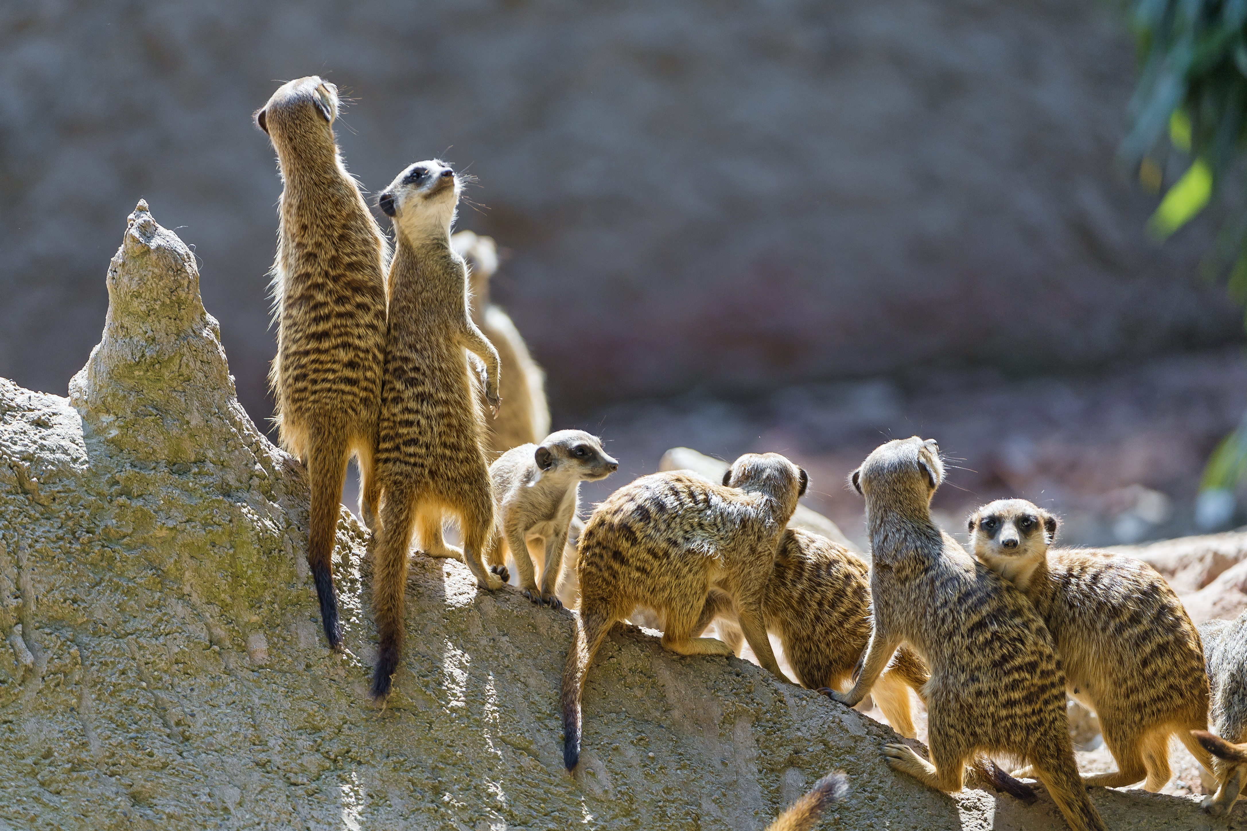
Biotic & Abiotic Influences
Population: a group of individuals of the same species

Slide 5
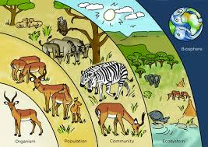
Biotic & Abiotic Influences
Biotic Factors: living things, their remains, and features, such as nests, associated with their activities
Examples: Plants, Animals, bacteria

Slide 6
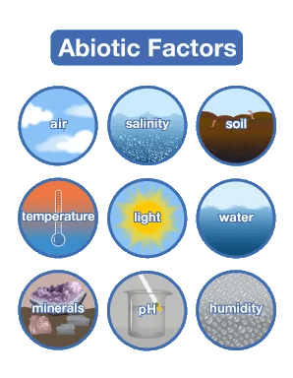
Biotic & Abiotic Influences
Abiotic Factors: the non-living physical and chemical components of an ecosystem
e.g. rocks
oxygen
water
sunlight

Slide 7
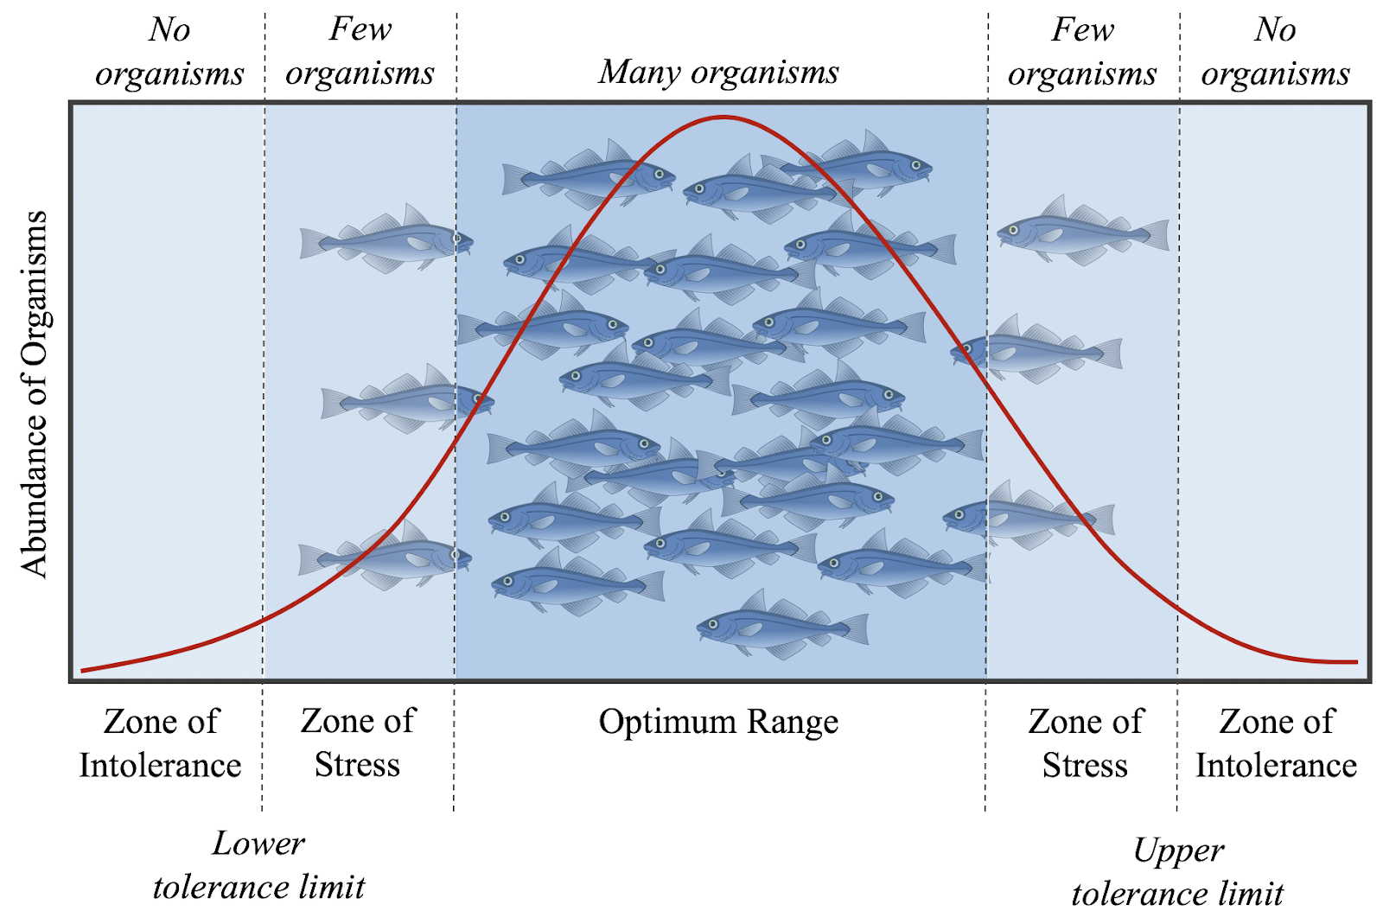
Biotic & Abiotic Influences
Limiting Factor: any factor that restricts the size of a population
e.g. biotic: availability of food
abiotic: access to water
Tolerance Range: the abiotic conditions within which a species can survive

Slide 8
Biotic & Abiotic Influences
Tolerance Range: the abiotic conditions within which a species can survive
Key abiotic factors:
-light availability
-water availability
-nutrient availability
-temperature

Slide 9
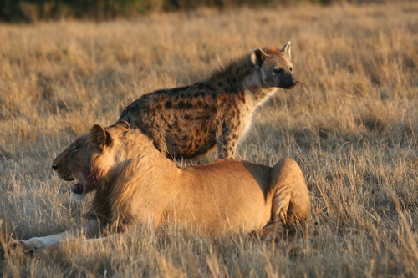
Biotic & Abiotic Influences
Competition: two individuals vying for the same resource
Intraspecific competition: a competition between individuals from the same species
Interspecific competition: the competition between individuals of different species.
Predation: one individual feeds on another

Slide 10
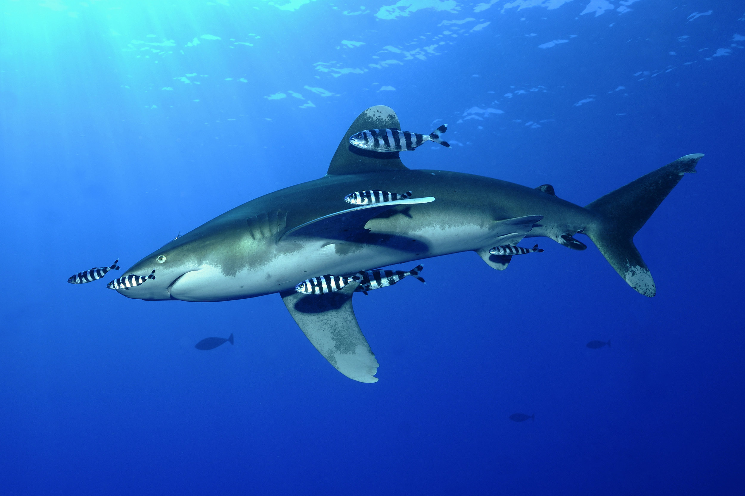
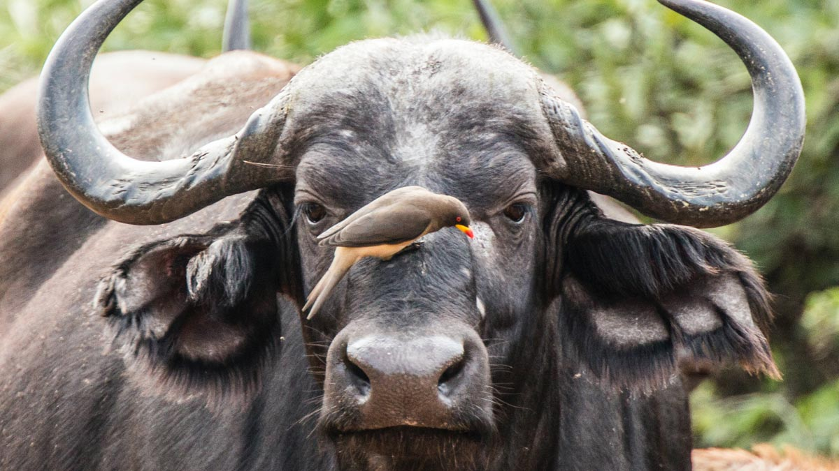
Biotic & Abiotic Influences
Symbiotic Relationships
Parasitism: one individual lives on or in and feeds on a host organism
Mutualism: two individuals benefitting each other
Commensalism: one individual benefits & the other neither benefits nor is harmed

Slide 11
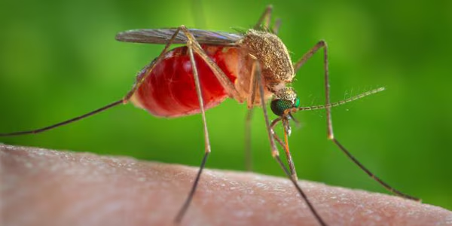
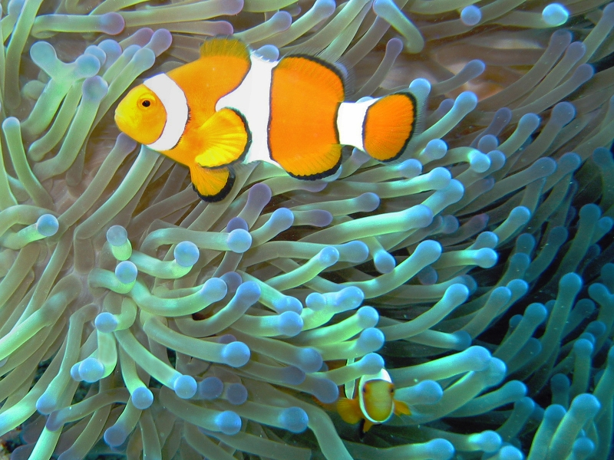
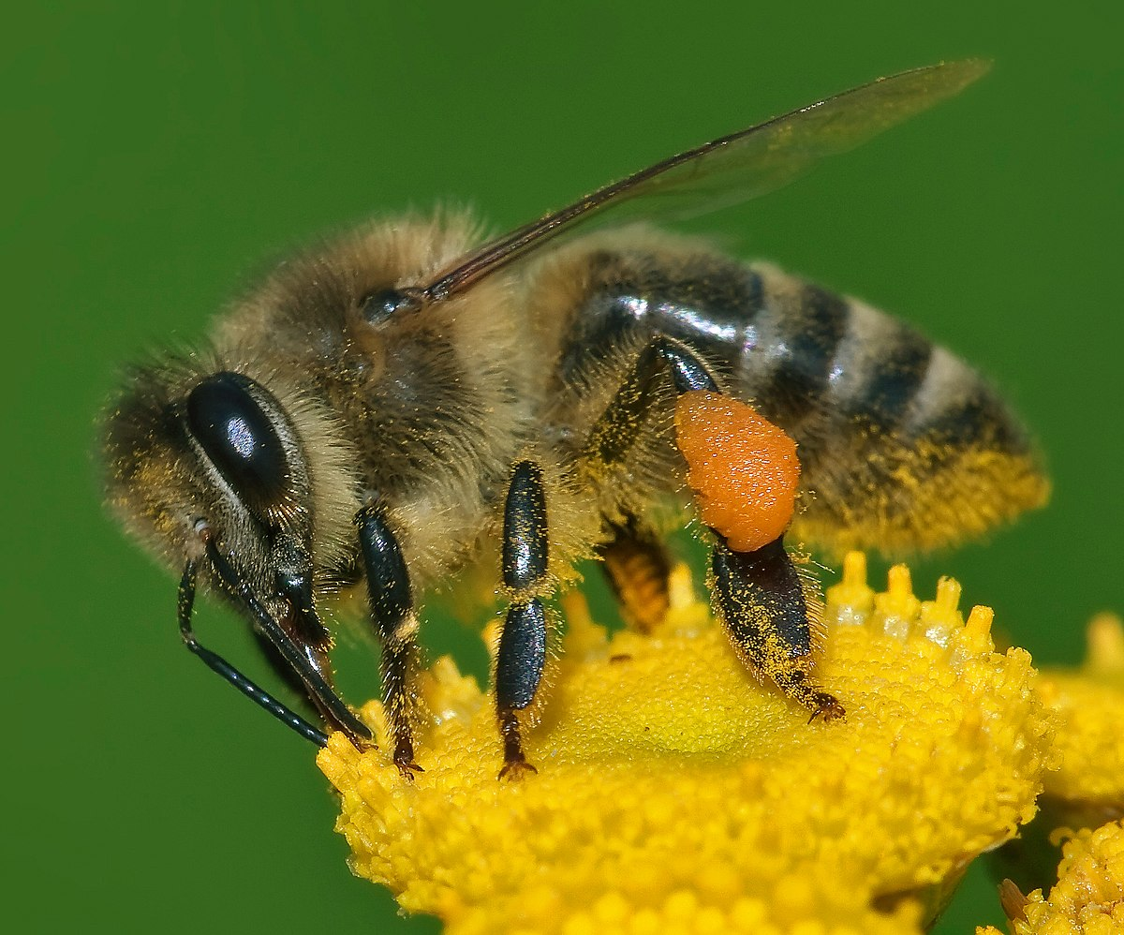

Slide 12
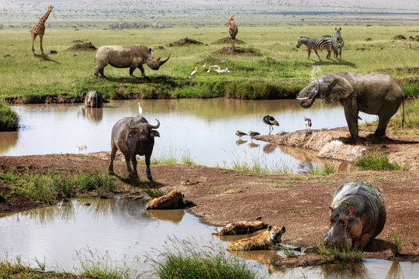
Biotic & Abiotic Influences

Slide 13
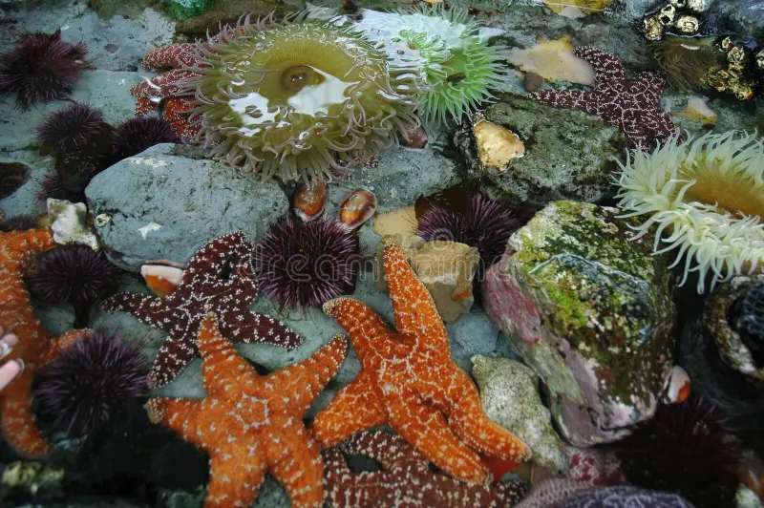
Biotic & Abiotic Influences

Slide 14
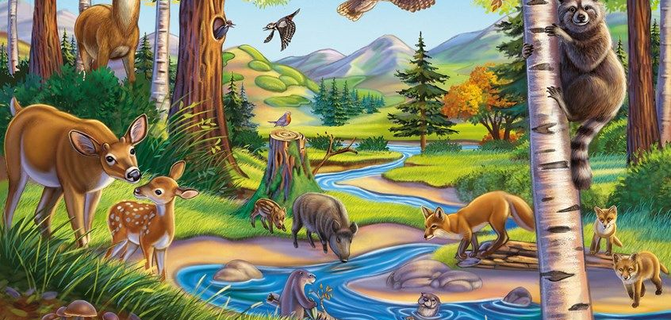
Biotic & Abiotic Influences

