Slide 1
Biology 10-Sex Linked Traits
Biology 10

Slide 2
Front Loading
What is the difference between a phenotype and a genotype?
The genotype of an organism is its complete set of genetic material.
Phenotype refers to an individual's observable traits, such as height, eye color and blood type. A person's phenotype is determined by both their genomic makeup (genotype) and environmental factors.
What does it mean for a gene to be expressed?
Expressed means that the genetic information encoded in a gene results in a phenotype.

Slide 3
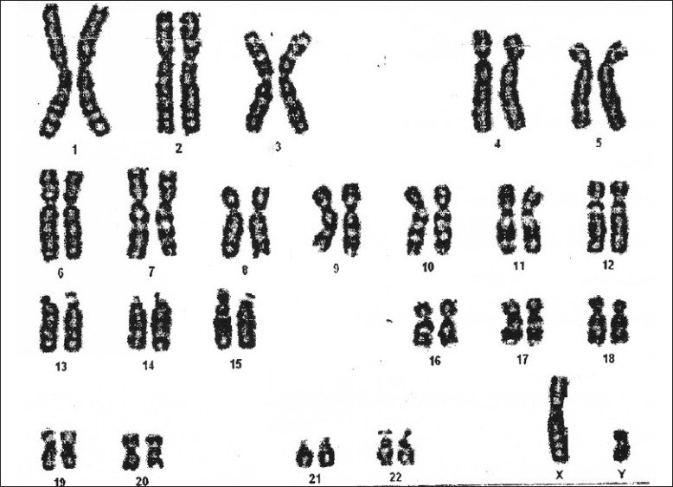
What are the Sex Chromosomes?

Slide 4
What are the Sex Chromosomes?

Slide 5
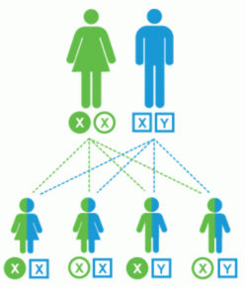
Sex Chromosomes
Every person receives one sex chromosome from each of their parents.

Slide 6
What are the non-sex chromosome called?

Slide 7
What are the non-sex chromosome Called?
Autosomes or autosomal chromosomes

Slide 8
What Does Sex-Linked Mean?
A sex-linked characteristics refer to traits that are influenced by genes carried on the sex chromosomes.

Slide 9
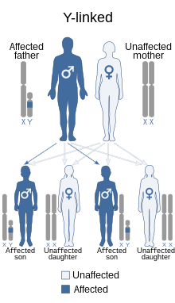
Y- Linked Traits
Y-Linked describes traits that are produced by genes located on the Y chromosome.
Can a female inherit Y-Linked Traits from her father?
Will all sons inherit Y-Linked Traits from their father?

Slide 10
Y- Linked Traits
Y-Linked describes traits that are produced by genes located on the Y chromosome.
Can a female inherit Y-Linked traits from her father?
No, because females do not have Y chromosomes
Will sons always inherit Y-Linked traits from their father?
Yes, because the father is the only source of Y chromosome

Slide 11
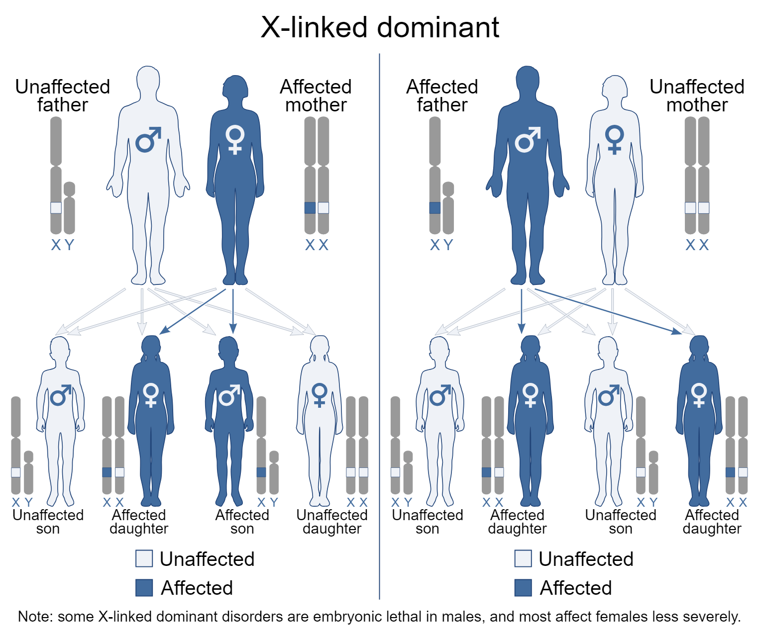
X-Linked Dominant Traits
X-linked dominant inheritance occurs when a gene responsible for a trait or disorder is located on the X chromosome.
This means that both males and females can display the trait or disorder when they have only one copy of the gene inherited from a parent.

Slide 12
Dominant X-Linked
Rett syndrome is a severe condition of the nervous system. It is almost only seen in females and affects all body movement. Rett syndrome may cause speech problems (such as inability to learn to speak, or loss of speech), difficulty walking or loss of the ability to walk, and loss of purposeful hand use.
Why are Dominant X-Linked Disorders most common in females and not males?

Slide 13
Dominant X-Linked
Rett syndrome is a severe condition of the nervous system. It is almost only seen in females and affects all body movement. Rett syndrome may cause speech problems (such as inability to learn to speak, or loss of speech), difficulty walking or loss of the ability to walk, and loss of purposeful hand use.
Because Females have 2 X chromosomes and males only have 1.
Why are Dominant X-Linked Disorders most common in females and not males?

Slide 14
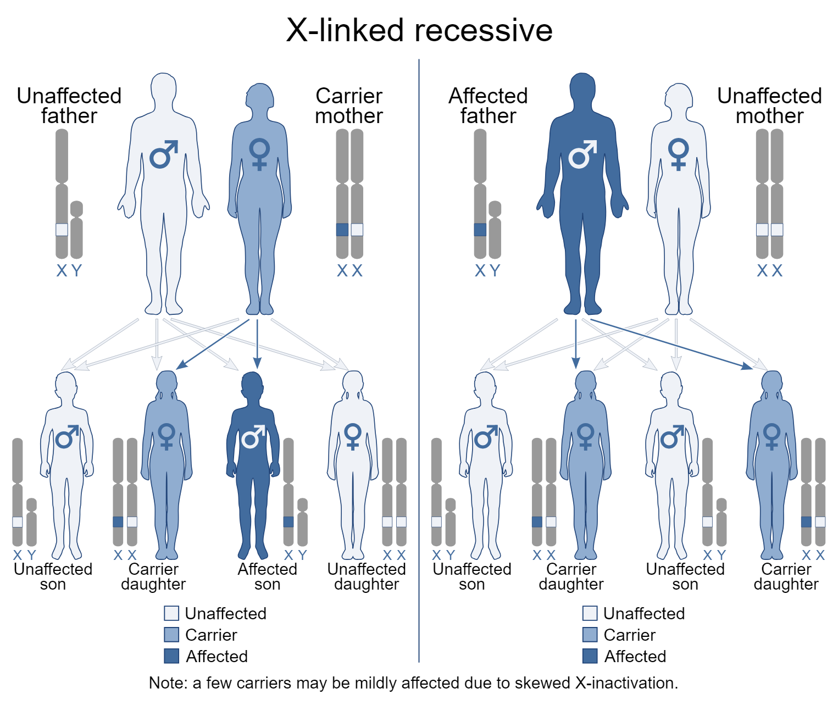
X-Linked Recessive Traits
Females can be carriers of X-Linked recessive traits but not be affected.
It is rare for females to express X-Linked-Recessive Traits.
Why are sons of affected father not also affected?

Slide 15
X-Linked Recessive Traits
Females can be carriers of X-Linked recessive traits but not be affected.
It is rare for females to express X-Linked-Recessive Traits.
Why are sons of affected fathers not also affected?
Because sons receive their only X chromosome from their mother

Slide 16
X-Linked Recessive Disorders
Hemophilia is an inherited bleeding disorder in which the blood does not clot properly. People with hemophilia have a higher likelihood of bleeding to death if they are injured.
About 1% of all people who have hemophilia are women.

Slide 17
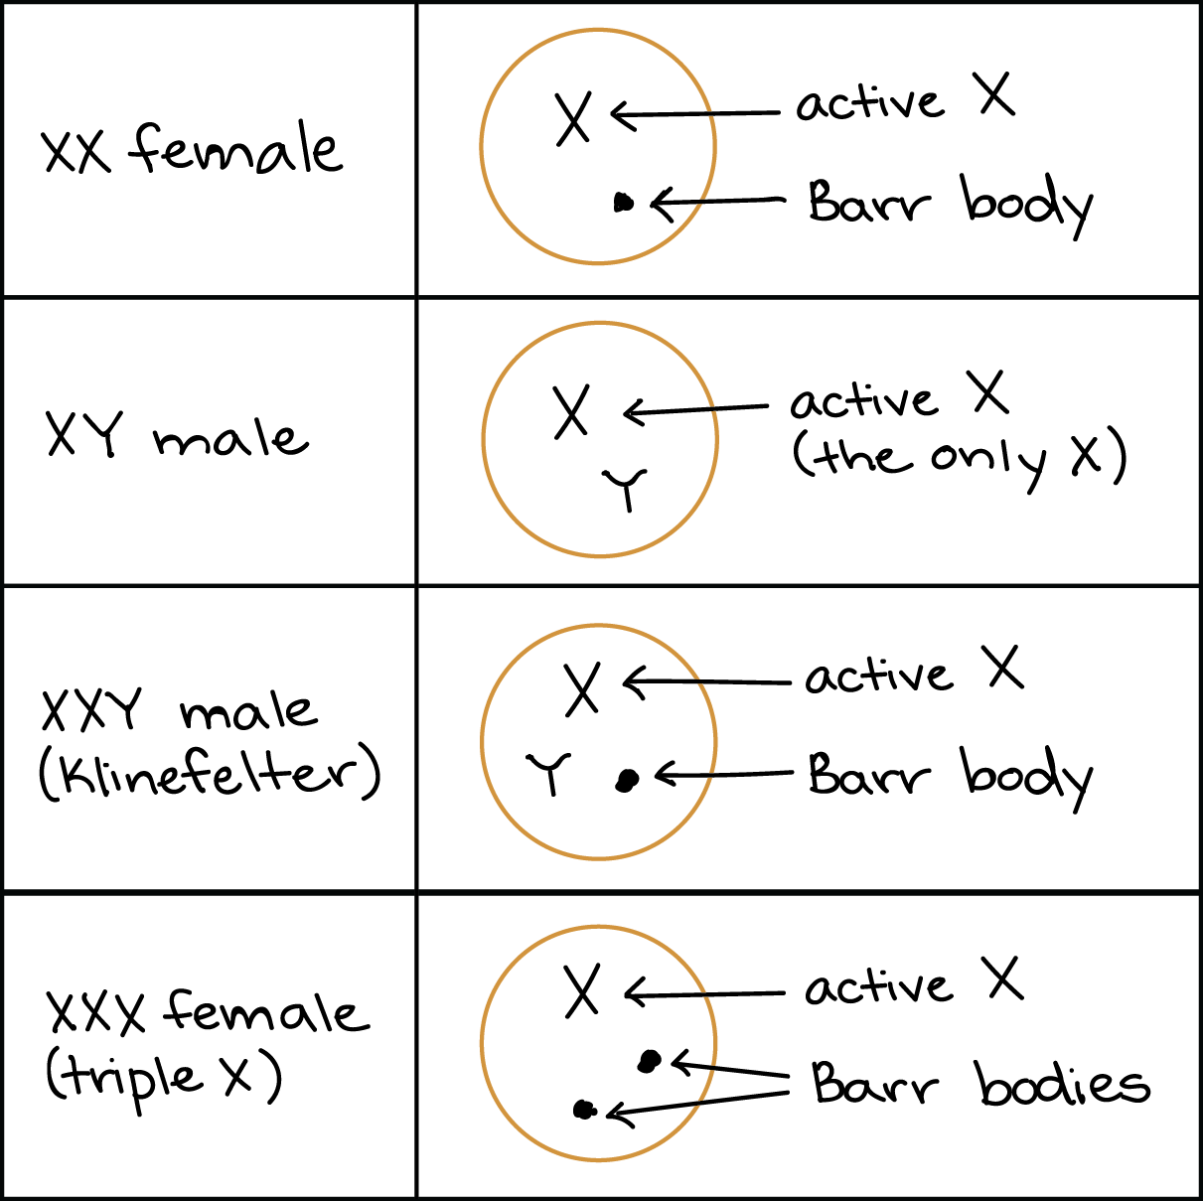
X Chromosome Inactivation or Lyonization
In Males there is an X and a Y Chromosome and both chromosomes are “activated”.
In Females there are 2 X chromosomes and 1 is inactivated. This is to ensure that like males, females only have 1 functional copy of the X chromosome.
Female identical twins may have different inactive X chromosomes. Therefore, would express different X-linked traits.

Slide 18
Why are Female orange cats less common than males?
The orange coat gene is carried on the X chromosome. For female cats to be orange they require 2 X chromosomes that carry the orange gene while male orange cats only require 1 X chromosome that carries the orange gene.
Calico males have 3 sex chromosomes (XXY) and are often sterile. The 3 sex chromosomes results from Non-disjunction.

Slide 19
X-Linked Recessive Traits
Red-Green Colour Vision Deficiency.

Slide 20
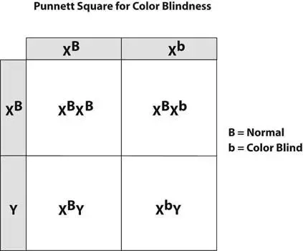
X-Linked Recessive Traits
Red-Green Colour Vision Deficiency.

Slide 21
Video
Amoeba Sisters- Sex Linked Chromosomes https://www.google.com/search?sca_esv=566330112&rlz=1C1CHBF_enCA918CA918&sxsrf=AM9HkKnh53UiW0j4ImUf6Ahd_ZAi3fzzQQ:1695070093841&q=sex+linked+traits&tbm=vid&source=lnms&sa=X&ved=2ahUKEwjj9LWhLWBAxXNODQIHSWJDzYQ0pQJegQIChAB&biw=1536&bih=715&dpr=1.25#fpstate=ive&vld=cid:53ba28f3,vid:h2xufrHWG3E,st:0

Slide 22
Biology 10-Pedigree
Biology 10

Slide 23
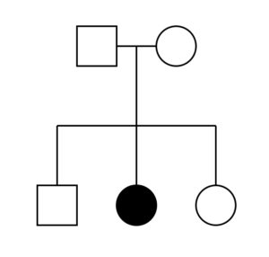
What is a pedigree chart?
A chart that diagrams the inheritance of a trait or health condition through generations of a family.

Slide 24
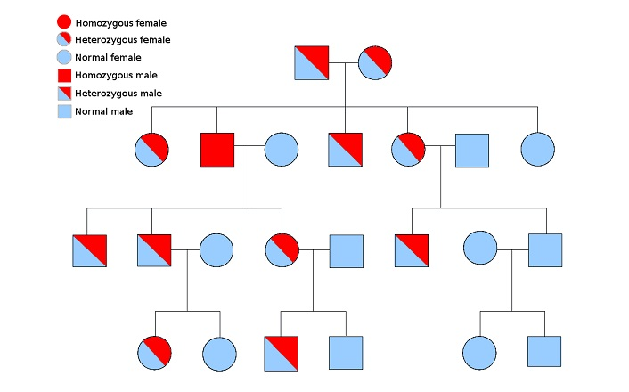
Reading Pedigree Charts
Circles Represent Female
Squares Represent Males
Filled in means effected
Half Filled in means carrier
Lines indicate close familial connection (Parent, child, sibling, or mate)

Slide 25
There are 5 Different Types of Pedigree Charts
1.) Autosomal Recessive
2.) Autosomal Dominant
3.) X-Linked Recessive
4.) X-Linked Dominant
5.) Y- Linked

Slide 26
Pedigree Charts

Slide 27
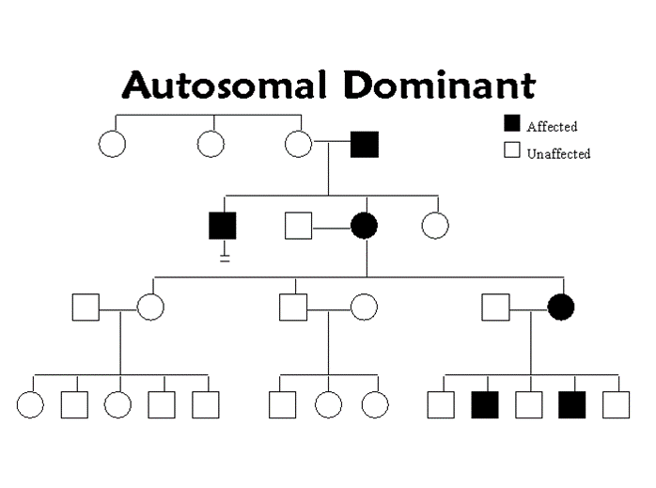
Autosomal Dominant Inheritance
Autosomal means not on the sex chromosomes.
Refers to those situations in which a single copy of an allele is sufficient to cause expression of a trait.

Slide 28
Autosomal Dominant Inheritance
1. Every affected person should have at least one affected parent.
2. Males and females should be equally affected.
3. An affected person has at least a 50% chance of transmitting the dominant allele to each offspring.

Slide 29
Autosomal Dominant Inheritance
Progeria (caused by a mutation) in which the person ages very rapidly. They die before they can reproduce.
Huntington’s Disease in which the central nervous system starts to break down around the age of 30.

Slide 30
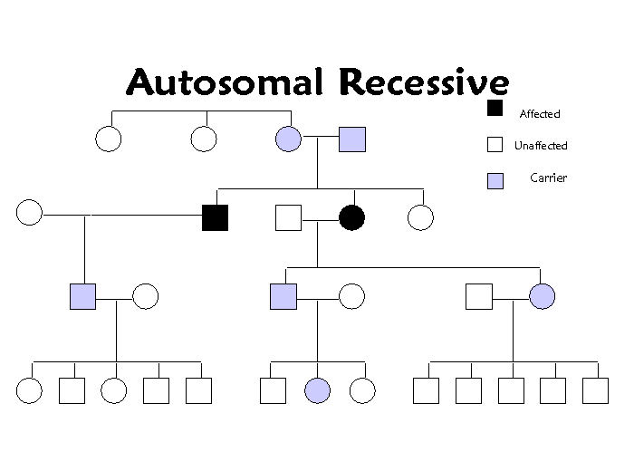
Autosomal Recessive Inheritance
Refers to those situations where two recessive alleles result in a trait being expressed.

Slide 31
Autosomal Recessive Inheritance
1. An affected person may not have affected parents. Parents would be carriers.
2. Affects both sexes equally. Can appear to skip generations.
3. Two affected parents will have affected children 100% of the time.

Slide 32
Autosomal Recessive Inheritance
Albinism is a genetic condition which is the loss of pigment in hair, skin and eyes.
Tay Sachs is a genetic disorder which is a buildup of fatty deposits in the brain, eventually proving to be fatal.

Slide 33
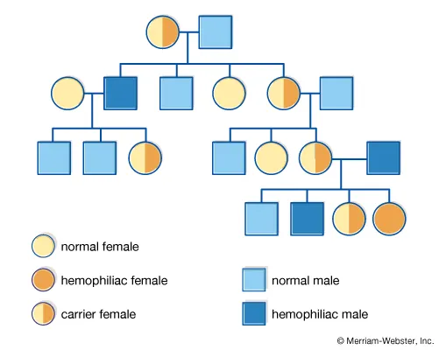
Interpreting Pedigree Charts
When looking at a pedigree chart you should ask yourself these questions:
Are the effected individuals present in every generation or does it skip a generation?
Are there carriers present?
Are only men or women impacted or both?
Do all offspring have the gene or only some?

Slide 34
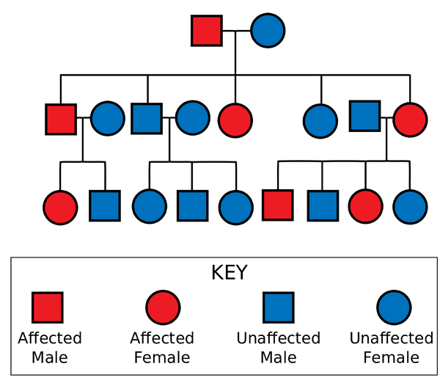
Interpreting Pedigree Charts
How many offspring exist from generation 1?
How many members of the family are affected?
There are no carriers present what does this mean? Is the disease caused by a dominant or a recessive trait?
Is the trait autosomal or Sex-Linked? How do you know?
Is the trait dominant or recessive?

Slide 35
Interpreting Pedigree Charts
How many offspring exist from generation 1? 5
How many members of the family are affected? 7
There are no carriers present what does this mean? Is the disease caused by a dominant or a recessive trait? Dominant
Is the trait autosomal or Sex-Linked? How do you know? Autosomal b/c male and females are impacted equally
Is the trait dominant or recessive? Dominant

Slide 36
Khan Academy- Pedigree Video
https://www.khanacademy.org/science/ap-biology/heredity/mendelian-genetics-ap/v/pedigrees

Slide 37
Sci 10-Mutations
Part 1

Slide 38
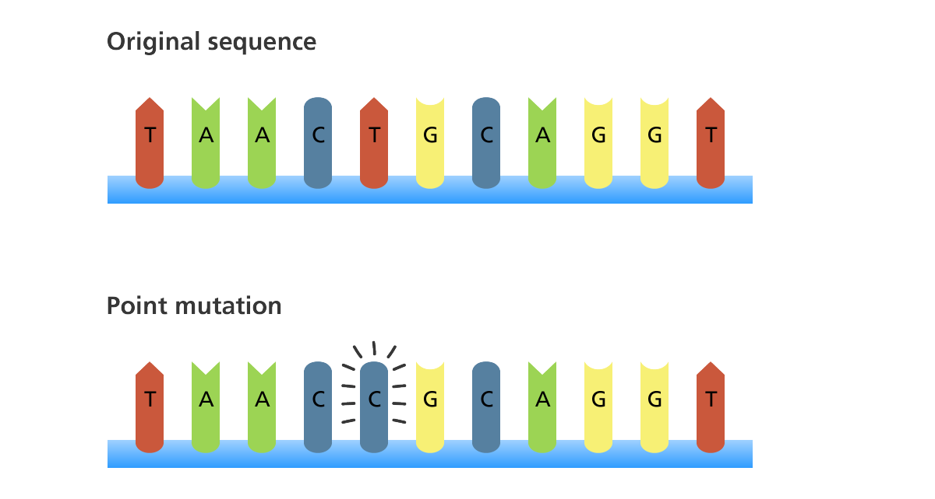
What is a Mutation?
Changes in the nucleotide sequence of DNA.

Slide 39
Mutations occur in 2 ways
Mutations can be inherited. This means that if a parent has a mutation in his or her DNA, then the mutation is passed on to his or her children.
Mutations can be acquired. This happens when environmental agents damage DNA, or when mistakes occur when a cell copies its DNA prior to cell division.

Slide 40
Are mutations helpful or harmful?
Mutations happen regularly – Everyone has mutations
Almost all mutations are neutral, but some are helpful or harmful
This can depend on environment
Chemicals & UV radiation cause mutations

Slide 41
Most Common Mutation in Humans
G-T mutation occurs once in every 10,000 to 100,000 base pairs.
Human genome has 3 billion base pairs.
Neutral Mutation- No effect on phenotype

Slide 42
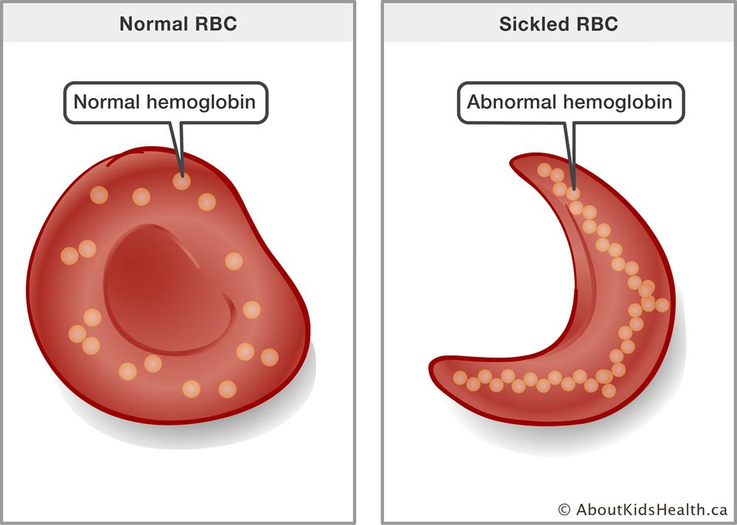
Harmful Mutations
They reduce the organism’s chance for survival and reproduction
Any mutation leading to a disease
Cancer- overexposure to UV light
Cystic fibrosis
Sickle-Cell Disease
Hemophilia

Slide 43
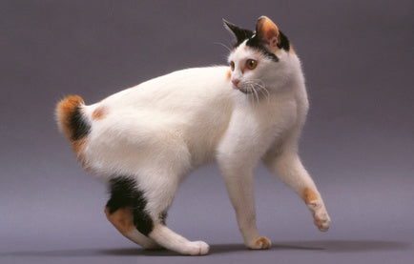
Neutral Mutations
These mutations do not show any advantages or disadvantages to an organism.

Slide 44
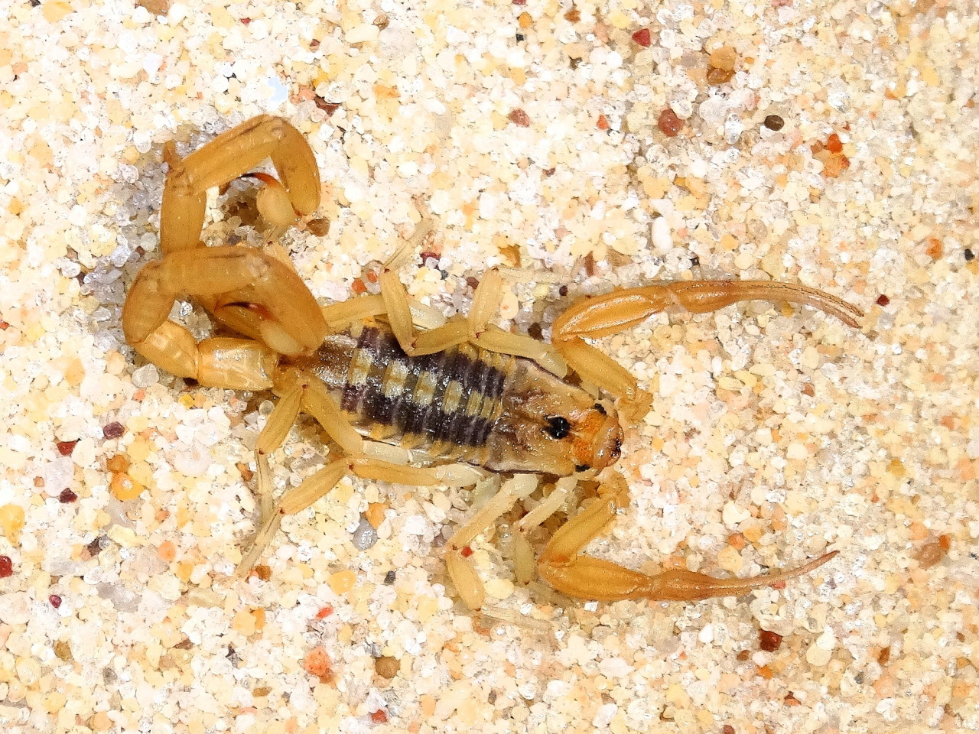
Helpful Mutations
Improve the organism's chance for survival and reproduction

Slide 45
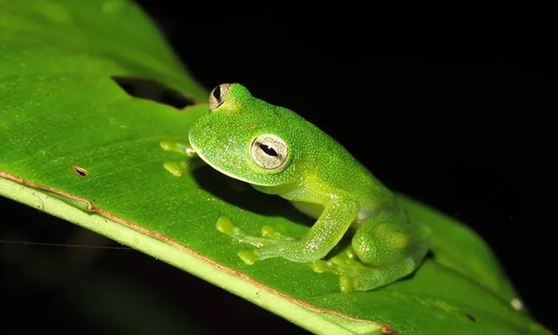
Mutations

Slide 46
Mutations

Slide 47
Mutations

Slide 48
Types of Chromosome Mutations
Five types exist:
Deletion
Inversion
Translocation
Nondisjunction
Duplication

Slide 49
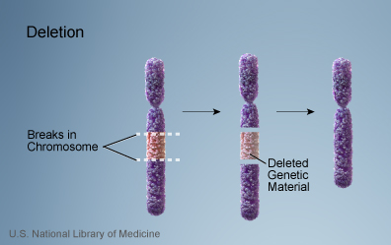
Deletion
Due to breakage
A piece of a chromosome is lost

Slide 50
Inversion
Chromosome segment breaks off
Segment flips around backwards
Segment reattaches

Slide 51
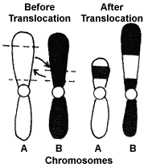
Translocation
Involves two chromosomes that aren’t homologous
Part of one chromosome is transferred to another chromosomes

Slide 52
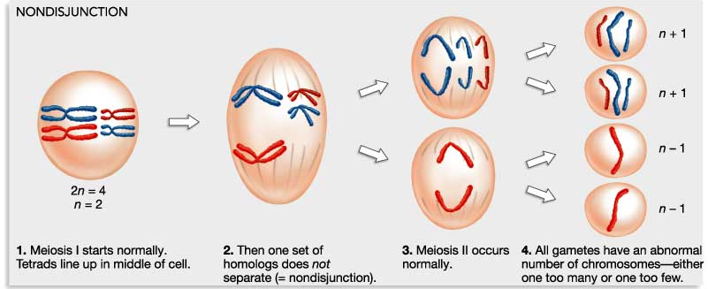
Nondisjunction
Failure of chromosomes to separate during meiosis
Causes gamete to have too many or too few chromosomes

Slide 53
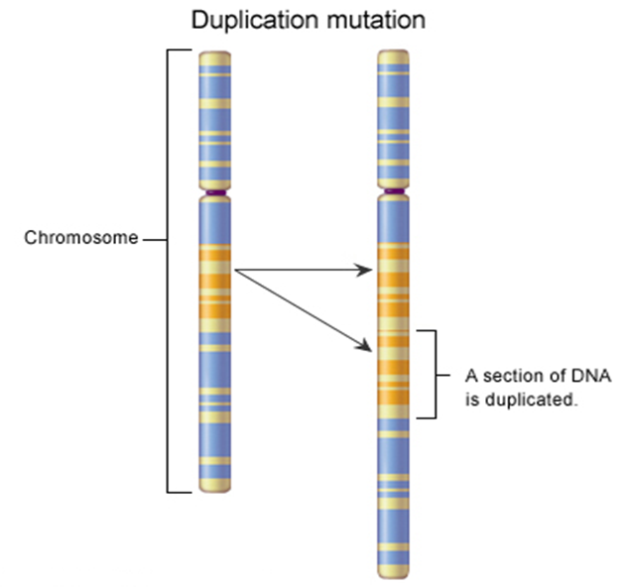
Duplication
Occurs when a gene sequence is repeated

Slide 54
Video (Amoeba Sisters)
https://www.youtube.com/watch?v=vl6Vlf2thvI

Slide 55
Sci 10-Mutations
Part 1

Slide 56
Translation Review

Slide 57
Translation Check
DNA | TAC GCG AAT AGT ACT
mRNA
Amino Acid

Slide 58
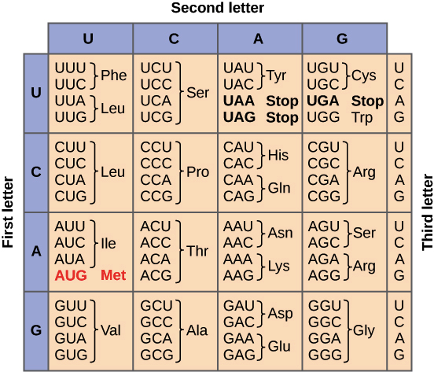
Translation Check
DNA | TAC GCG AAT AGT ACT
mRNA | AUG CGC UUA UCA UGA
Amino Acid

Slide 59
Translation Check
DNA | TAC GCG AAT AGT ACT
mRNA | AUG CGC UUA UCA UGA
Amino Acid | met – arg – leu – ser – stop

Slide 60
Gene Mutations
Change in the nucleotide sequence of a gene
May only involve a single nucleotide
May be due to copying errors, chemicals, viruses, etc.

Slide 61
Types of Gene Mutations
Point Mutations
Substitutions
Insertions
Deletions
Frameshift

Slide 62
Point Mutations
Change of a single nucleotide
Includes the deletion, insertion, or substitution of ONE nucleotide in a gene

Slide 63
Point Mutation- Silent silent mutation – order of amino acids after translation does not change
 | Original Strand | Mutated Strand
DNA | TAC GCG AAT AGT ACT | TAC GCG AAT AGG ACT
mRNA | AUG CGC UUA UCA UGA | AUG CGC UUA UCC UGA
Amino Acid

Slide 64
Point Mutation-Silent
 | Original Strand | Mutated Strand
DNA | TAC GCG AAT AGT ACT | TAC GCG AAT AGG ACT
mRNA | AUG CGC UUA UCA UGA | AUG CGC UUA UCC UGA
Amino Acid | met – arg – leu – ser – stop | met – arg – leu – ser – val

Slide 65
Point Mutation- Missense missense mutation – order of amino acids changes
 | Original Strand | Mutated Strand
DNA | TAC GCG AAT AGT ACT | TAC GCG AAT GGT ACT
mRNA | AUG CGC UUA UCA UGA | AUG CGC UUA CCA UGA
Amino Acid

Slide 66
Point Mutation- Missense missense mutation – order of amino acids changes
 | Original Strand | Mutated Strand
DNA | TAC GCG AAT AGT ACT | TAC GCG AAT GGT ACT
mRNA | AUG CGC UUA UCA UGA | AUG CGC UUA CCA UGA
Amino Acid | met – arg – leu – ser – stop | met – arg – leu – pro – stop

Slide 67
Point Mutations-Nonsense
nonsense mutation – mRNA codes for an early stop codon
 | Original Strand | Mutated Strand
DNA | TAC GCG AAT AGT ACT | TAC GCG ATT AGT ACT
mRNA | AUG CGC UUA UCA UGA | AUG CGC UAA UAA UGA
Amino Acid

Slide 68
Point Mutations-Nonsense
nonsense mutation – mRNA codes for an early stop codon
 | Original Strand | Mutated Strand
DNA | TAC GCG AAT AGT ACT | TAC GCG ATT AGT ACT
mRNA | AUG CGC UUA UCA UGA | AUG CGC UAA UAA UGA
Amino Acid | met – arg – leu – ser – stop | met – arg – stop

Slide 69
Frameshift Mutations
a change in the reading frame of RNA caused by adding or removing bases

Slide 70
Frameshift Mutation-Deletion
Deletion Mutation – loss of a base or bases causing a shortening of the amino acids sequence
 | Original Strand | Mutated Strand
DNA | TAC GTG CGA AAT GAT | TAC GGC GAA ATG AT
mRNA | AUG CAC GCU UUA CUA | AUG CCG CUU UAC UA
Amino Acid

Slide 71
Frameshift Mutation-Deletion
Deletion Mutation – loss of a base or bases causing a shortening of the amino acids sequence
 | Original Strand | Mutated Strand
DNA | TAC GTG CGA AAT GAT | TAC GGC GAA ATG AT
mRNA | AUG CAC GCU UUA CUA | AUG CCG CUU UAC UA
Amino Acid | met – his – ala – leu – leu | met – pro – leu – tyr

Slide 72
Frameshift Mutations- Insertion
Insertion Mutation – addition of a base or bases causing a lengthening of the amino acid sequence
 | Original Strand | Mutated Strand
DNA | TAC GTG CGA AAT GAT | TAC GTA GCG AAA TGA T
mRNA | AUG CAC GCU UUA CUA | AUG CAU CGC UUU ACU A
Amino Acid

Slide 73
Frameshift Mutations- Insertion
Insertion Mutation – addition of a base or bases causing a lengthening of the amino acid sequence
 | Original Strand | Mutated Strand
DNA | TAC GTG CGA AAT GAT | TAC GTA GCG AAA TGA T
mRNA | AUG CAC GCU UUA CUA | AUG CAU CGC UUU ACU A
Amino Acid | met – his – ala – leu – leu | met – his – arg – phe – thr

Slide 74
Frameshift Mutations
Frameshift mutations usually result in more harmful effects since there is often a greater change in the amino acid sequence.

Slide 75
Summary
Chromosome Mutations
Deletions, Insertions, Translocations, Non-disjunctions, Duplications
Gene Mutations
Point Mutation: Silent, Missense, Nonsense
Frameshift Mutations: Deletions, Insertions

Slide 76
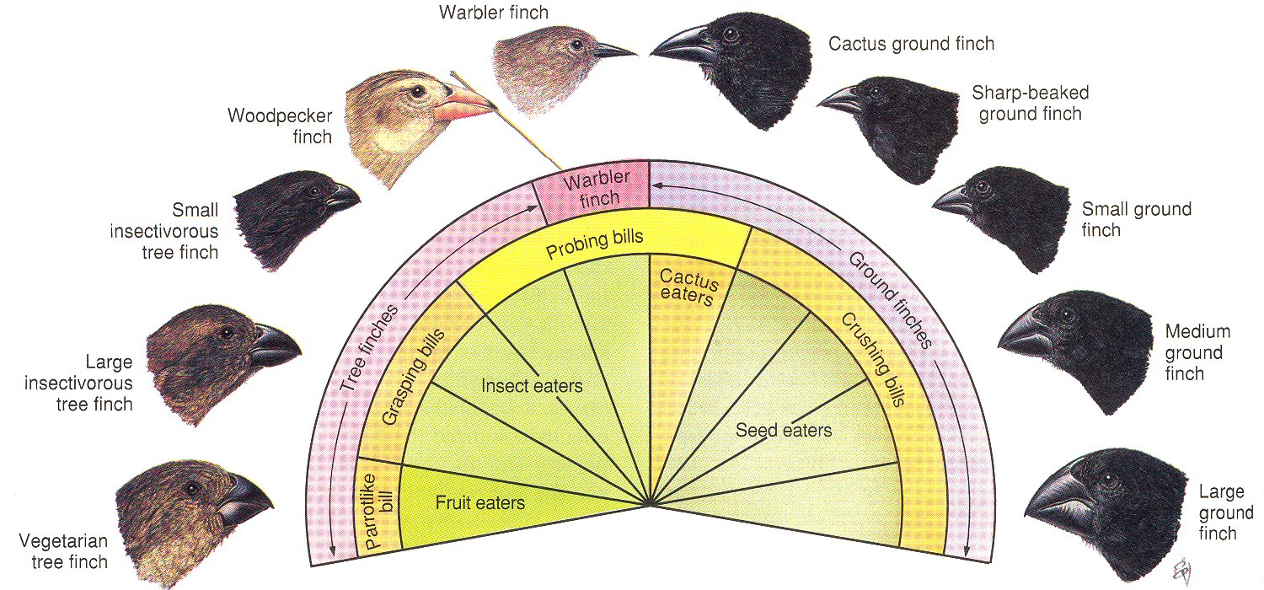
Mutations Further
Cannot be cured- Only Treated (Examples: Cancer and Sickle Cell)
Adaptations can stem from mutations but are favorable for species and help them survive and reproduce.

Slide 77
Video
https://www.youtube.com/watch?v=lzhp5NuXo-k

Slide 78
Sci-10 Natural Selection

Slide 79
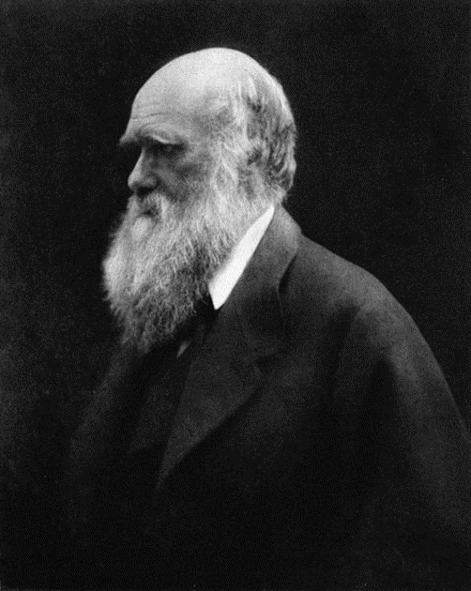
Charles Darwin
Video: https://www.youtube.com/watch?v=JOk_0mUT_JU (5 mins)

Slide 80
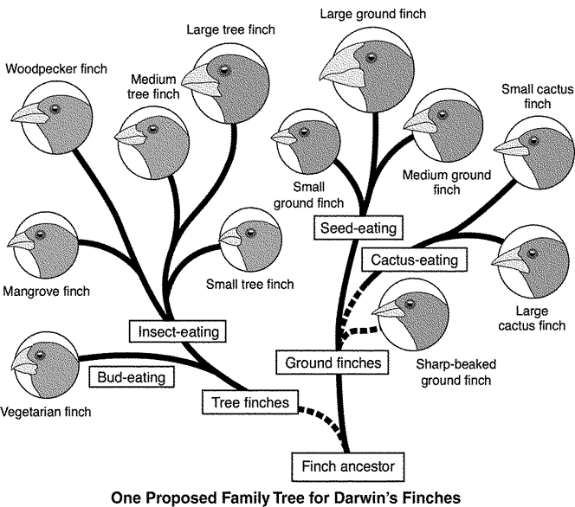
Charles Darwin
Developing the Theory of Evolution
The Galápagos Islands
Darwin noticed that the different islands all seemed to have their own, slightly different varieties of animals.
Somewhat similar species that suited their particular environment.

Slide 81
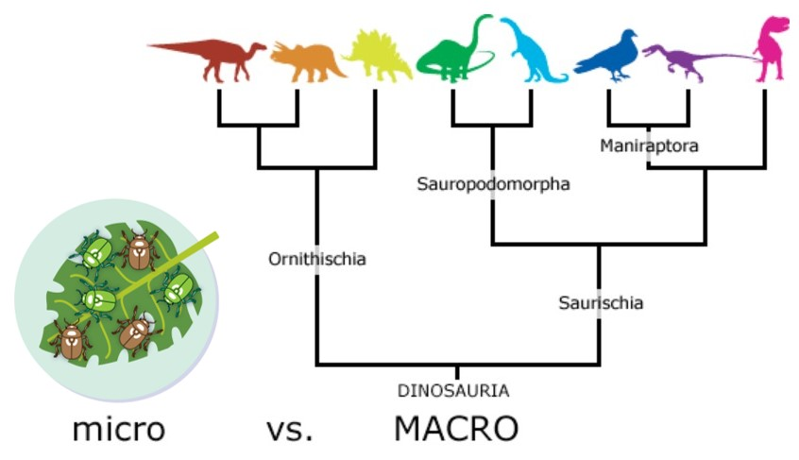
Introduction
Evolution – includes all of the changes in the characteristics and diversity of life that occur throughout time.
Evolution can occur on both large and small scales.
Microevolution
Macroevolution

Slide 82
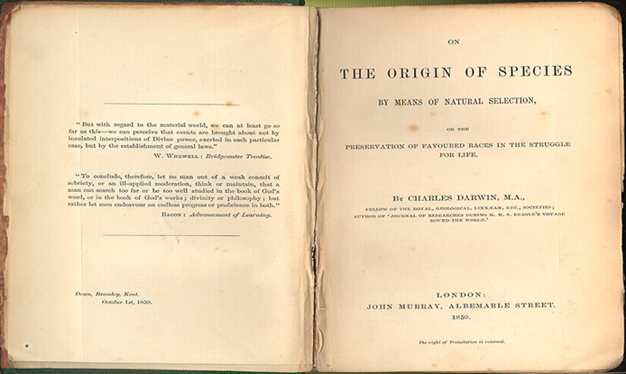
Origin of Species: Darwin’s Book
In 1859 On the Origin of Species presented evidence and proposed a mechanism for evolution that he called natural selection.

Slide 83
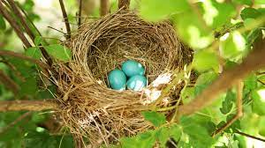
Natural Selection
Survival of the fittest
Natural selection is a process of elimination
Organisms that have traits that are best adapted for the current environment are the ones that survive to breed and pass on their genes to the next generation, causing a change in the overall population.
Biological fitness- The ability of an organism to survive and reproduce (pass on its genes)

Slide 84
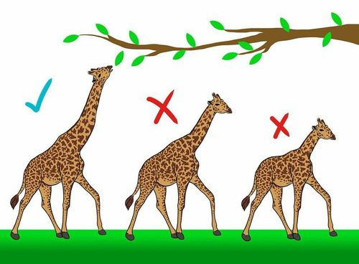
Natural Selection
Natural Selection requires three features:
Variation: There is variation in a trait between and within populations.
Heredity: The variation probably has a genetic basis.
Differential reproduction: The variants of the trait have different probabilities of surviving to reproduction.

Slide 86
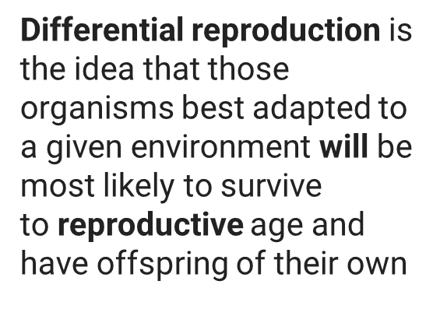

Slide 87
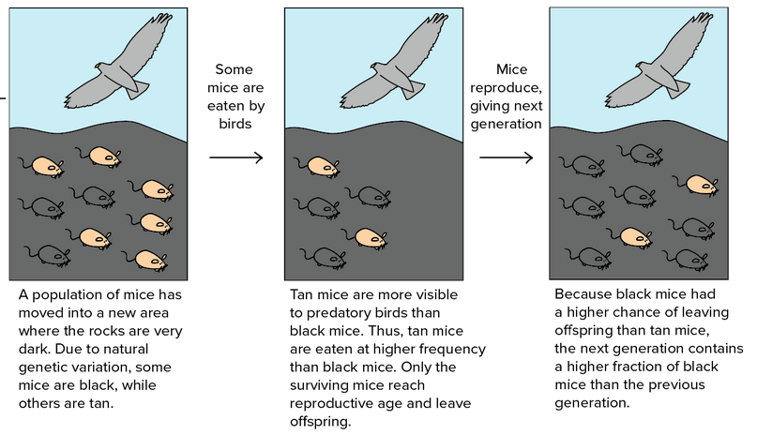
Selective Advantage
A genetic advantage that improves an organism's chance of survival, usually in a changing environment.

Slide 88
Variation
Genetic Variation is present in the population, and it is inherited (passed to offspring)
Mutations: Changes in the DNA
Meiosis: crossing over
Random mate selection & fertilization

Slide 89
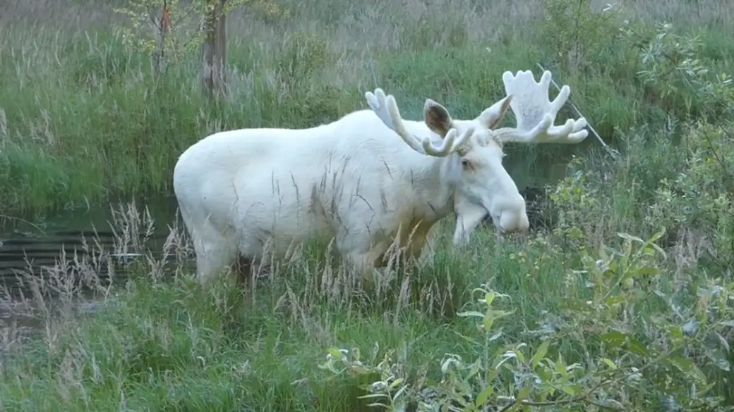
Variation-Mutations
Mutations provide changes in the DNA . Mutations provide new alleles and are sources of new genetic variation when inherited.

Slide 90
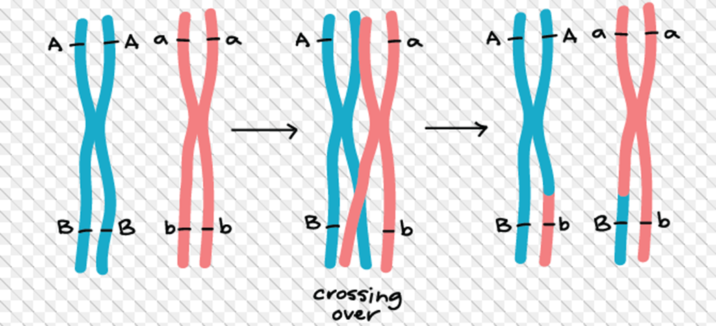
Variation-Crossing Over
Crossing over leads to genetic variation.
Crossing over is why siblings can have the same parents but still may look very different (except for identical twins etc.).

Slide 91
Adaptation
Adaptations-a change or the process of change by which an organism or species becomes better suited to its environment.
Types of adaptations
Camouflage is a suite of morphological adaptations that allow an organism to blend into its environment.
Mimicry is a type of morphological adaptation where a species evolves to resemble another species.
Antibiotic resistance develops in some bacteria,making them able to survive antibiotic treatments

Slide 92
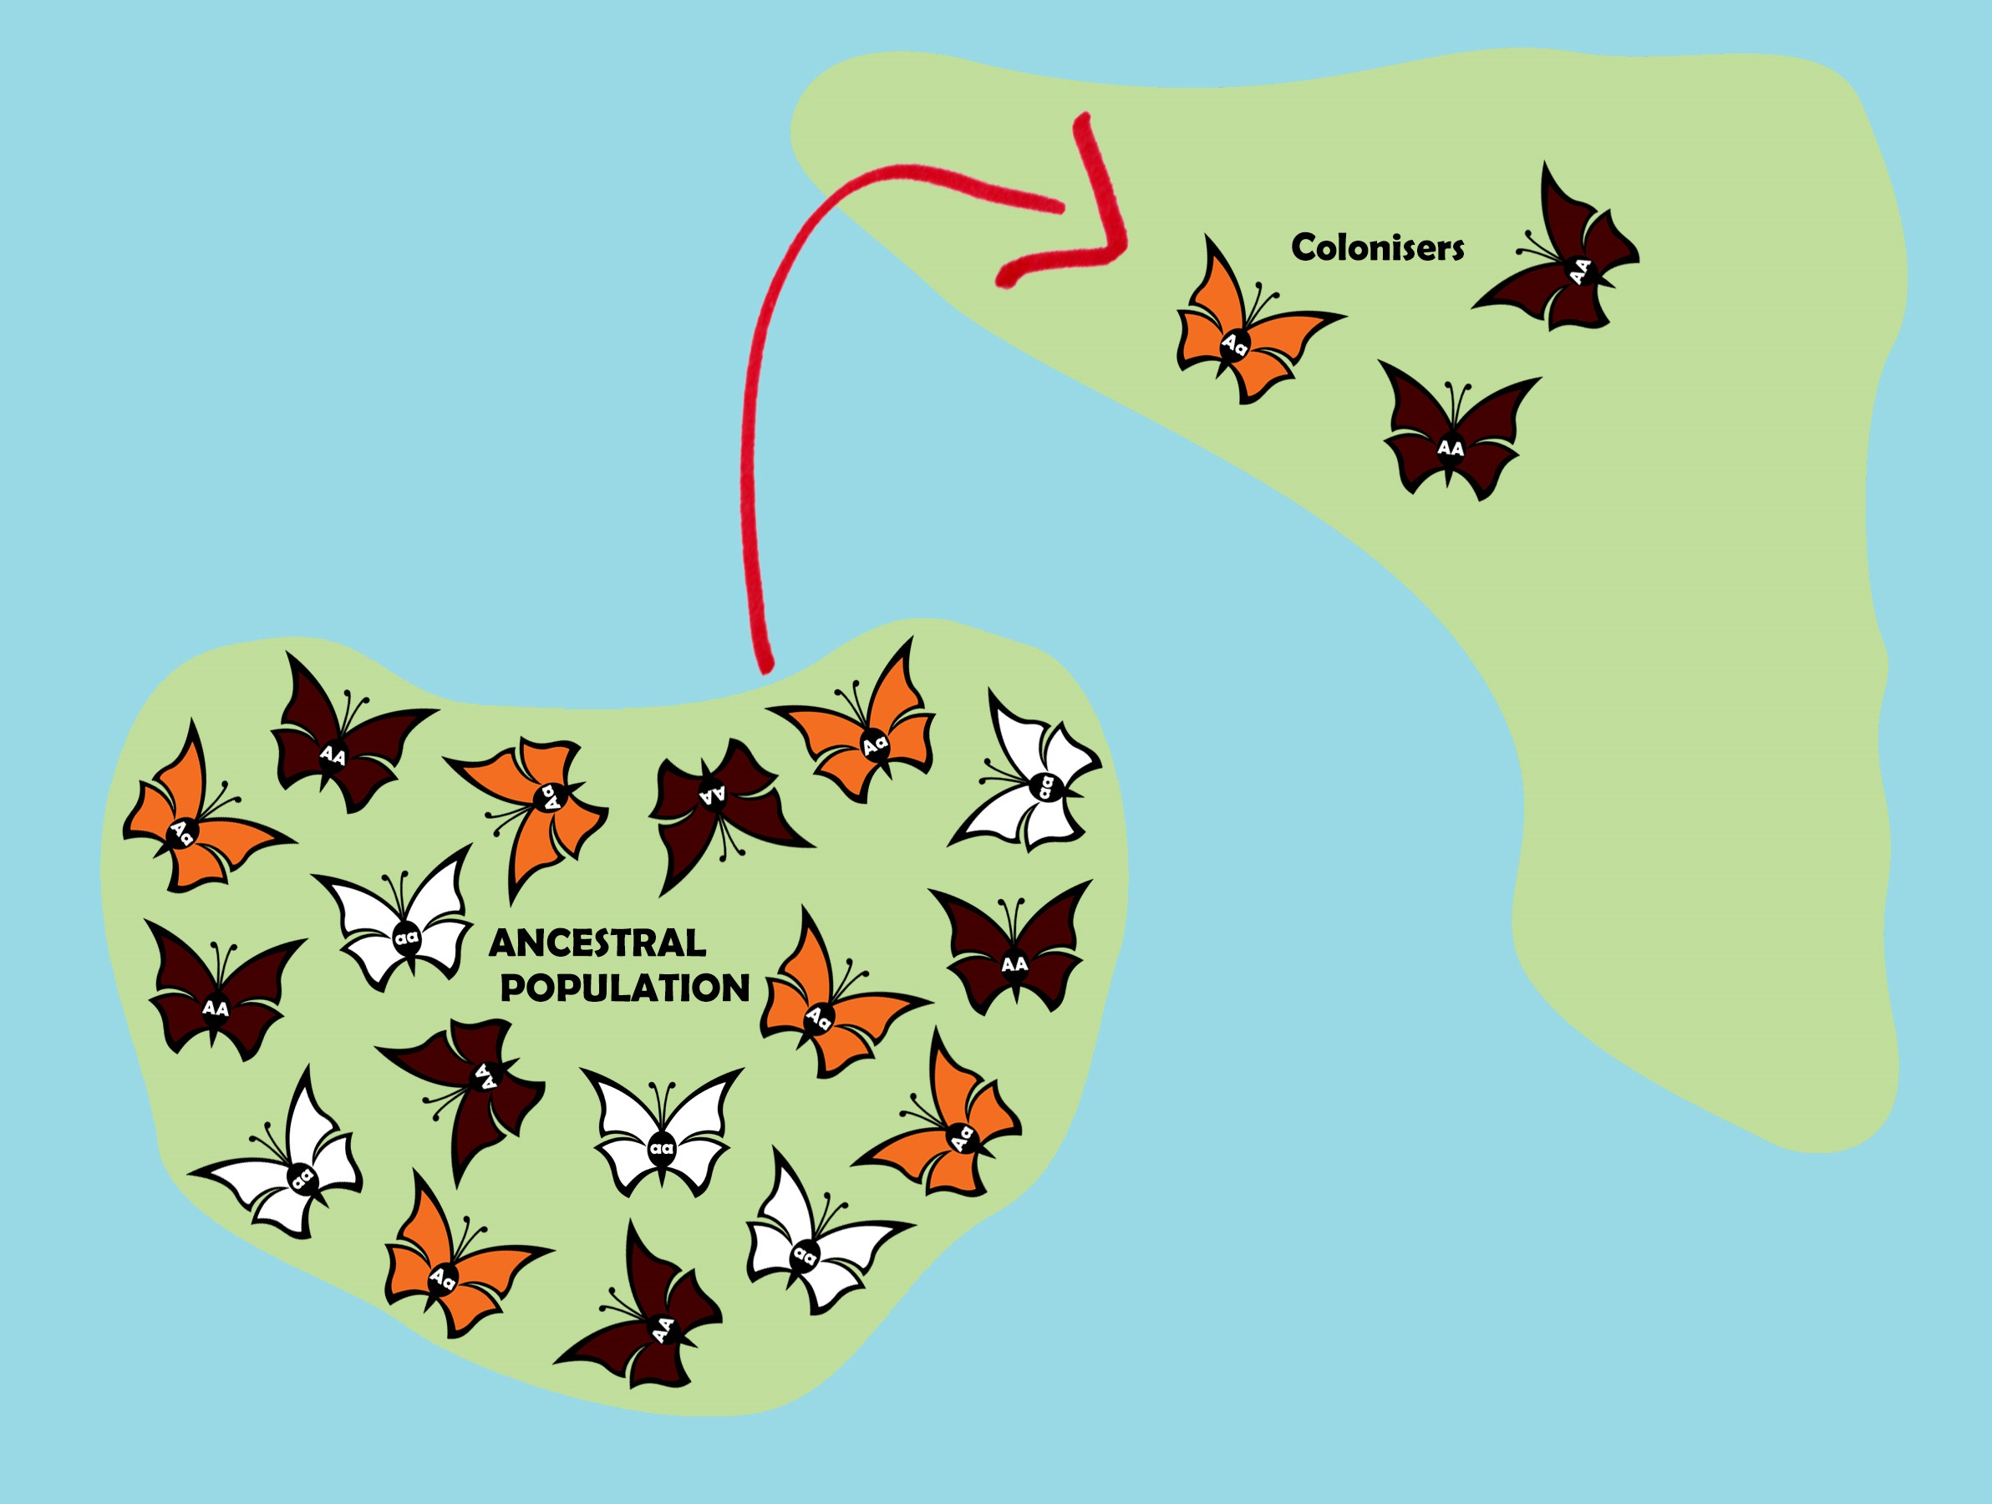
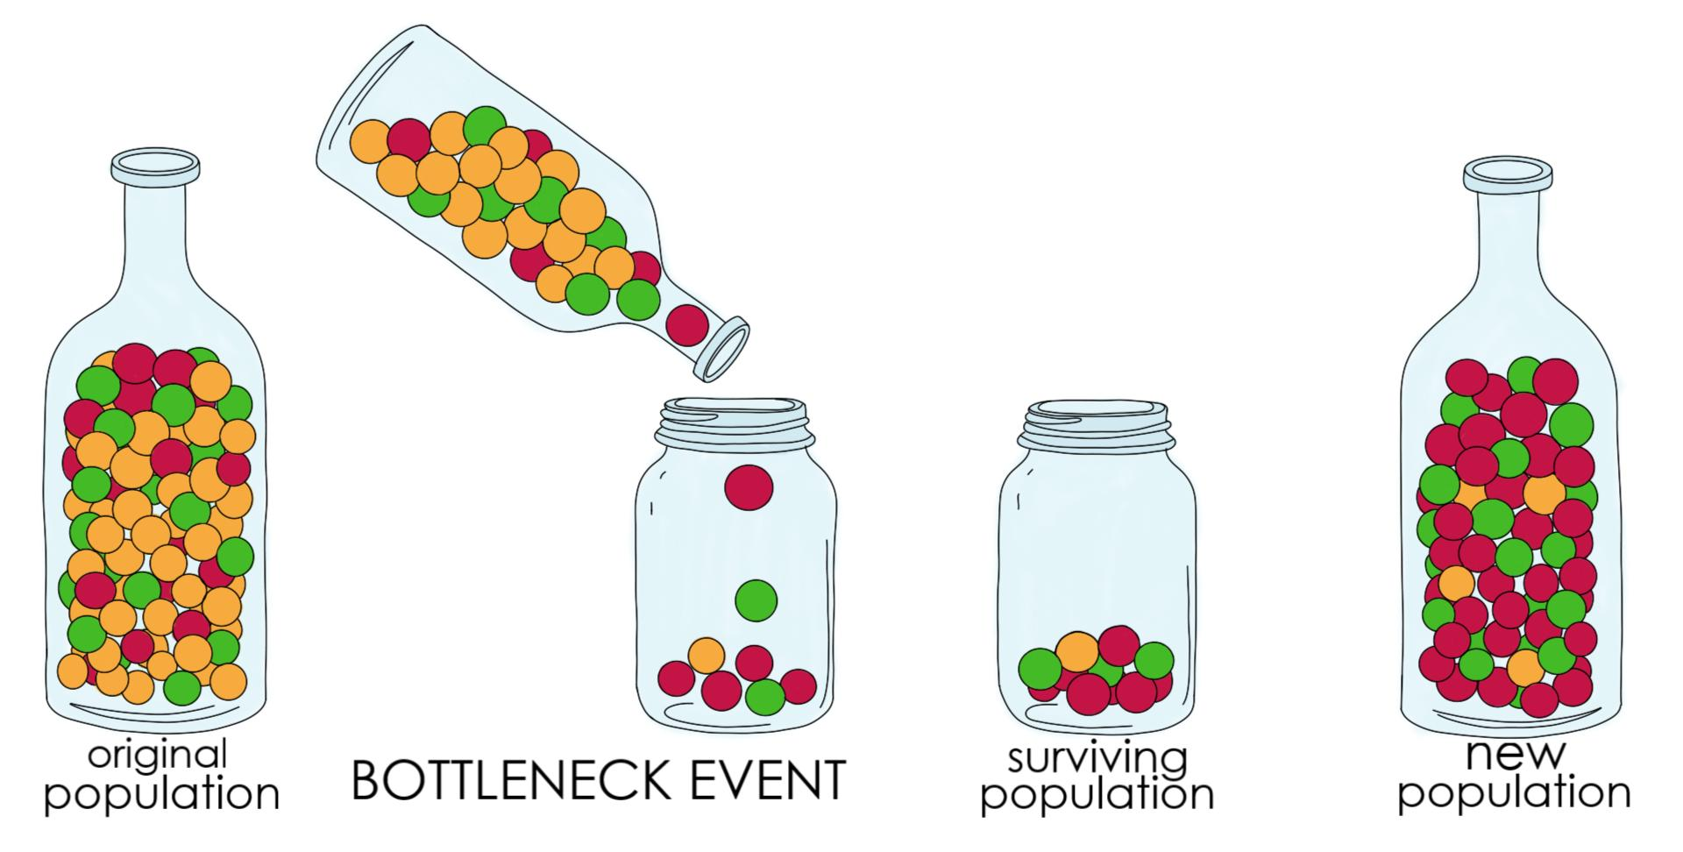
Genetic Drift
Effect of chance events
founder effect
small group splinters off & starts a new colony
Skews the gene pool of the new population
bottleneck
some factor (disaster) reduces population to small number & then population recovers & expands again
alleles lost from gene pool, narrows the gene pool

Slide 93
Gene Flow
Movement of individuals & alleles in & out of populations
seed & pollen distribution by wind & insect
migration of animals
sub-populations may have different allele frequencies
causes genetic mixing across regions
reduce differences between populations

Slide 94
Speciation
Speciation- the formation of a new species from an existing species
can occur with a single population
example: horses
over thousands of years, horses have slowly gotten larger and their body shape has changed
caused by natural selection acting on the species as a whole
one species becoming another species

Slide 96
Adaptive Radiation
• when two or more different populations of the same species live in different types of habitats, the environmental pressures acting on them might not be the same and the two populations would start to change independent of each other
Forest Population | Mountain Population
climb trees camouflage in trees shorter sight-lines | climb over rocks camouflage in rocks farther sight-lines

Slide 97
Adaptive Radiation
• if the two populations change enough compared to each other, they can stop being able to produce offspring together
•example: Galapagos finches
•finch population blown to Galapagos Islands (15 islands) from South America
•different food types on the different islands
• finches on different islands gradually evolved different beak sizes to match the food types

Slide 98
Extinction & Selective Pressure
• Selective pressures caused by environmental changes can also cause a species to become extinct
• major catastrophic events can lead to dramatic changes in the environment
• example: asteroid impact caused large amounts of dust and soot to be thrown into the atmosphere blocked out solar energy change in global temperature caused the extinction of the dinosaurs
fossil records indicate that there have been 5 mass extinction events (75% or greater loss of species)

Slide 99
Artificial Selection

Slide 100
Artificial Selection
Artificial selection occurs when populations are subjected to human controlled selection pressures
also called selective breeding

Slide 101
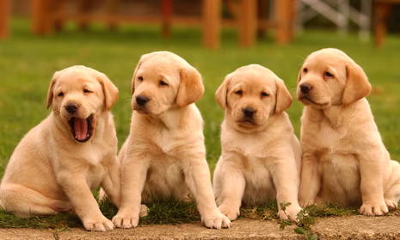
Artificial Selection Examples
allows for the breeding of specific traits within a species:
dogs – protection (guard dogs), hunting, companion

Slide 102
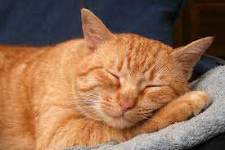
Artificial Selection Examples
allows for the breeding of specific traits within a species:
cats – hair length, colour

Slide 103
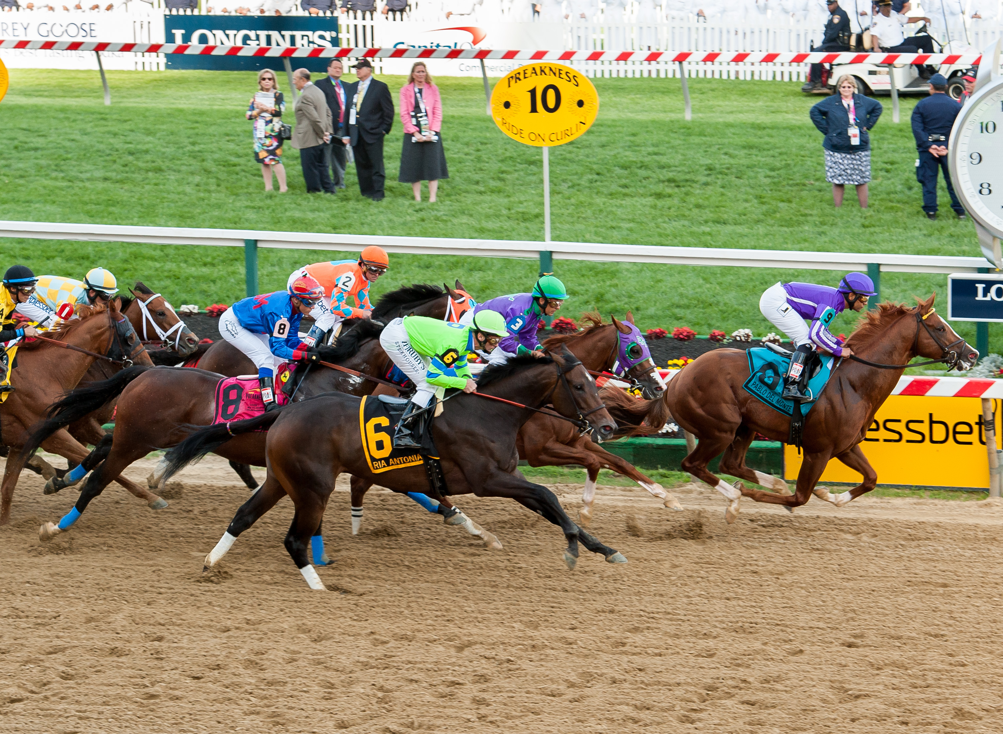
Artificial Selection Examples
allows for the breeding of specific traits within a species:
horses – speed, strength, size

Slide 104
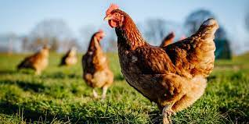
Artificial Selection Examples
allows for the breeding of specific traits within a species:
chickens – size of egg, laying frequency, size (meat birds)

Slide 105
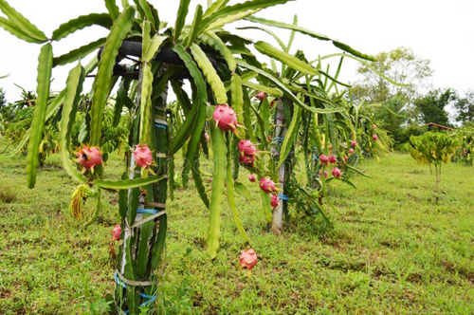
Artificial Selection Examples
allows for the breeding of specific traits within a species:
fruits & vegetables – size, flavor, pit attachment (free stone peaches for canning)

Slide 106
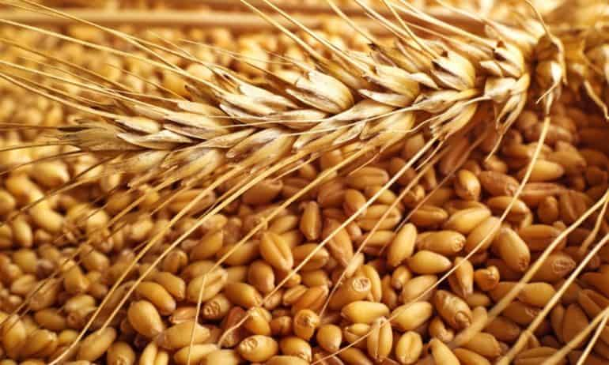
Artificial Selection Examples
allows for the breeding of specific traits within a species:
grains – hardiness, amount of grain produced, disease resistance

Slide 107
Artificial Selection Example

Slide 108
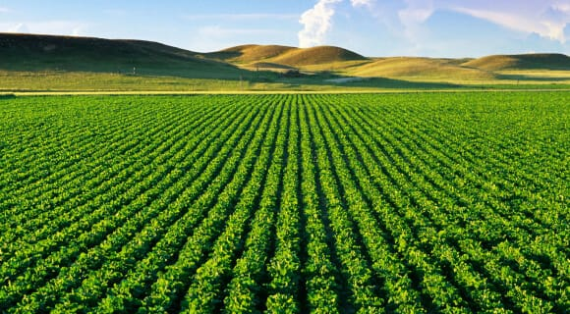
Artificial Selection
Monoculture-repeated planting of the same varieties of species over a large expanse of land.
Polyculture- Planting various varieties of plants over a large expanse of land.

Slide 109
The Three Sisters

Slide 110
What are some benefits and risks associated with artificial selection of agricultural crops?

Slide 111
What are some benefits and risks associated with artificial selection of agricultural crops?
Benefits- Plants can grow larger and have more desirable traits and survive longer.
Risks- Plants may have an increased risk of genetic diseases. Less variability also leads to less resilient crops to sickness or pests.

Slide 112
Natural Versus Artificial

Slide 113
Questions
Questions
1. For each of the organisms listed below, identify two or three traits that may have been selectively bred for. (Hint: think of what each organism is used for.)
a. sheep
b. corn
c. apples
d. mandarin oranges
e. cows
f. chickens

Slide 114
Video
https://www.youtube.com/watch?v=fHS-OY9XDZc (5 mins)
https://www.youtube.com/watch?v=9hzWbTpxME8 (3 Mins)

Slide 115
Videos Genes
Genetic Engineering – YouTube (8 mins)
https://www.youtube.com/watch?v=kAtd9X29SdQ (Gene Therapy (4 mins))
Are GMOs Good or Bad? Genetic Engineering & Our Food – YouTube (10 mins)

