Slide 1
Lesson 7- Other Patterns of Inheritance
Biology 10

Slide 2
Learning Outcomes
I can distinguish between co-dominance, incomplete dominance, multiple-allele, and polygenic traits.
I can use a Punnett square to determine the probability of genotypes and/or phenotypes for co-dominance, incomplete dominance and multiple allele traits.

Slide 3
Co-Dominance
results when different alleles for the same trait are present in different parts of the organism
examples: hair colour of calico cats, flowers with different colours on the petals

Slide 4
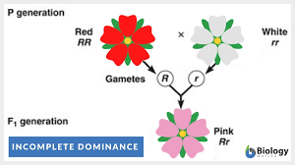
Incomplete Dominance
results when the phenotype of heterozygous individuals is a blending of the dominant and recessive traits
examples: white and red carnations produce pink carnations.

Slide 5
Multiple-Allele Traits
a trait for which there are more than two alleles occurring at the same gene location on a chromosome
Example: blood typing (3 different alleles)
Blood Type | Genotype | Phenotype
A | I^{A}I^{A} or I^{A}i | Type A Blood
B | I^{B}I^{B} or I^{B}i | Type B Blood
AB | I^{A}I^{B} | Type AB Blood
O | ii | Type O Blood

Slide 6
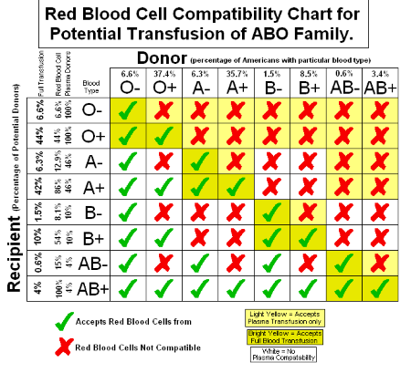
Multiple-Allele Traits
blood type can be dominant/recessive (I^{A}i or ii) or codominant (I^{A}I^{B})
if asked, “I” for blood type stands for isoagglutinogen, another term for antigen
in addition to this, blood is also listed as Rh positive or negative
this is an autosomal trait

Slide 7
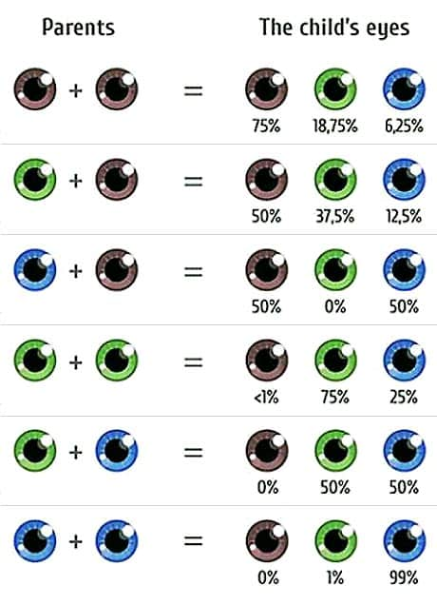
Polygenetic Traits
Eye colour
two genes (OCA2 and HERC2) on chromosome 15 have a major role in eye colour – these produce and regulate the amount of melanin (pigmentation) in the iris
less melanin = lighter (blue) eyes
more melanin = darker eyes (brown)
an additional 14 other genes have minor roles in determining smaller variations in eye colour (ex: shades of blue)

