Slide 1
Lesson 4- Biodiversity
Biology 10

Slide 2
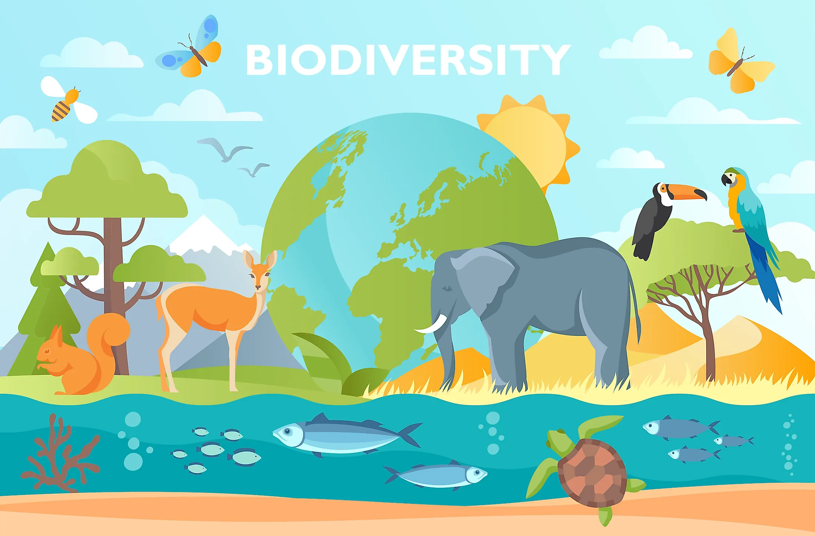
Learning Outcomes
I can describe how genetic diversity accounts for differences between individuals, species and ecosystems.

Slide 3
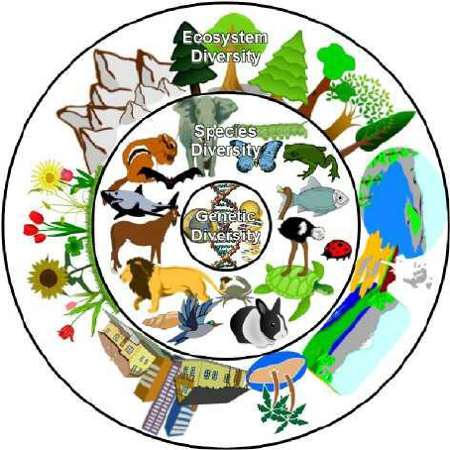
Biodiversity
every living organism – plant, animal, fungus, protist, or bacteria – has its own unique genetic code
this genetic uniqueness creates a biodiversity that can be compared at 3 different levels

Slide 4
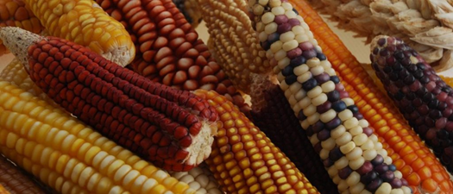
Genetic Diversity
differences that occur between members of the same population or species
any 2 humans have a genetic similarity of approximately 99.7%
all of the differences between any 2 people only accounts for 0.3% of their DNA

Slide 5
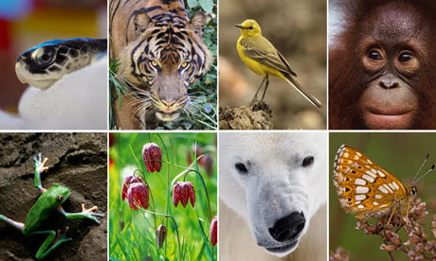
Species Diversity
each species has their own number of chromosomes and DNA make-up
fruit fly has 4 pairs of chromosomes
dogs have 39 pairs of chromosomes
scientists have catalogued over 1.74 million different living species
estimates on the total number of species ranges from 8.7 million to 1 trillion

Slide 6
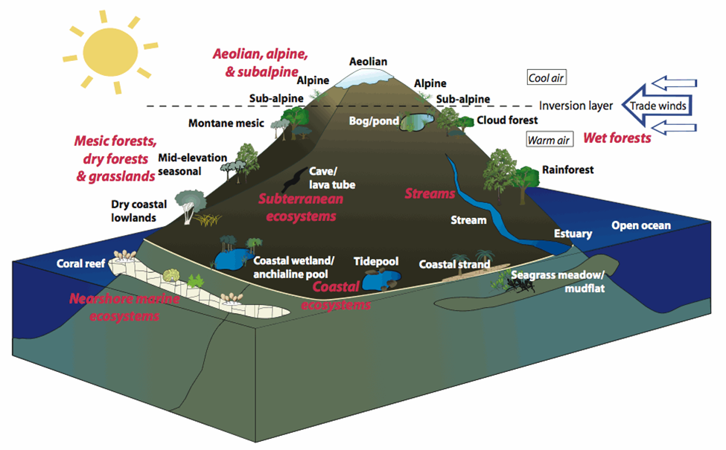
Ecosystem Diversity
the variety of different ecosystems on the planet
ecosystems are composed of both living and non-living components
means that there is variation between 2 different boreal forests within BC

Slide 7
Should we value Biodiversity?

