Slide 1
Lesson 3- DNA Replication
Biology 10

Slide 2
Learning Outcomes
Learning Outcomes:
I can describe the basic process of DNA replication.
I can describe how a DNA gene sequence is used to make a protein.

Slide 3
DNA Replication
prior to mitosis, all of the genetic material in a cell needs to be duplicated
called DNA replication
bonds between 2 strands of DNA of a chromosome are broken by the enzyme DNA helicase
new nucleotides are attached to each strand of DNA following complimentary base pairing by the enzyme DNA polymerase
forms 2 identical double-stranded copies
called semi-conservative replication because one strand in each new chromosome is conserved from the original chromosome

Slide 5
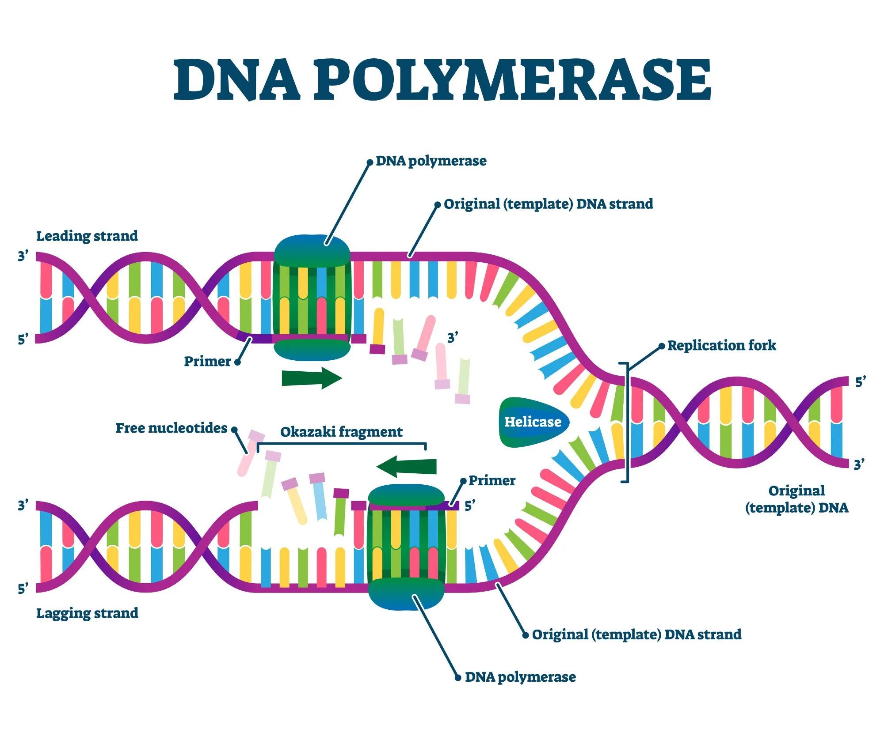
Protein Formation- Transcription
two-step process
Transcription
since DNA is too large to fit through a pore in the nuclear membrane, it needs to create a smaller messenger
a gene sequence unwinds and one side of the chromosome is copied as a messenger RNA (mRNA)

Slide 6
DNA vs RNA
DNA | RNA
double stranded bases are Adenine (A) – Thymine (T) and Cytosine (C) – Guanine (G) sugar is deoxyribose | single strand bases are Adenine (A) – Uracil (U) and Cytosine (C) – Guanine (G) sugar is ribose

Slide 7
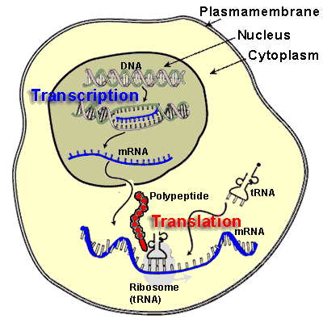
Example
DNA T A C G C G A A T T G T C A C T A G A C C A C T
RNA A U G C G C U U A A C A G U G A U C U G G U G A

Slide 8
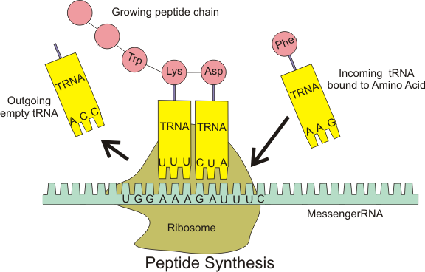
Protein Formation- Translation
Translation
mRNA moves into the cytoplasm and binds with a ribosome
ribosome translates the instructions in the mRNA into a chain of amino acids
mRNA is read in sets of 3 bases called a codon that codes for a specific amino acid

Slide 10
Example
RNA AUG CGC UUA ACA GUG AUC UGG UGA
Amino Acid met – arg – leu – thr – val – ile – trp – stop
chain of amino acids is then folded up into its functional shape

