Slide 1
Chromosomes
Science 10

Slide 2
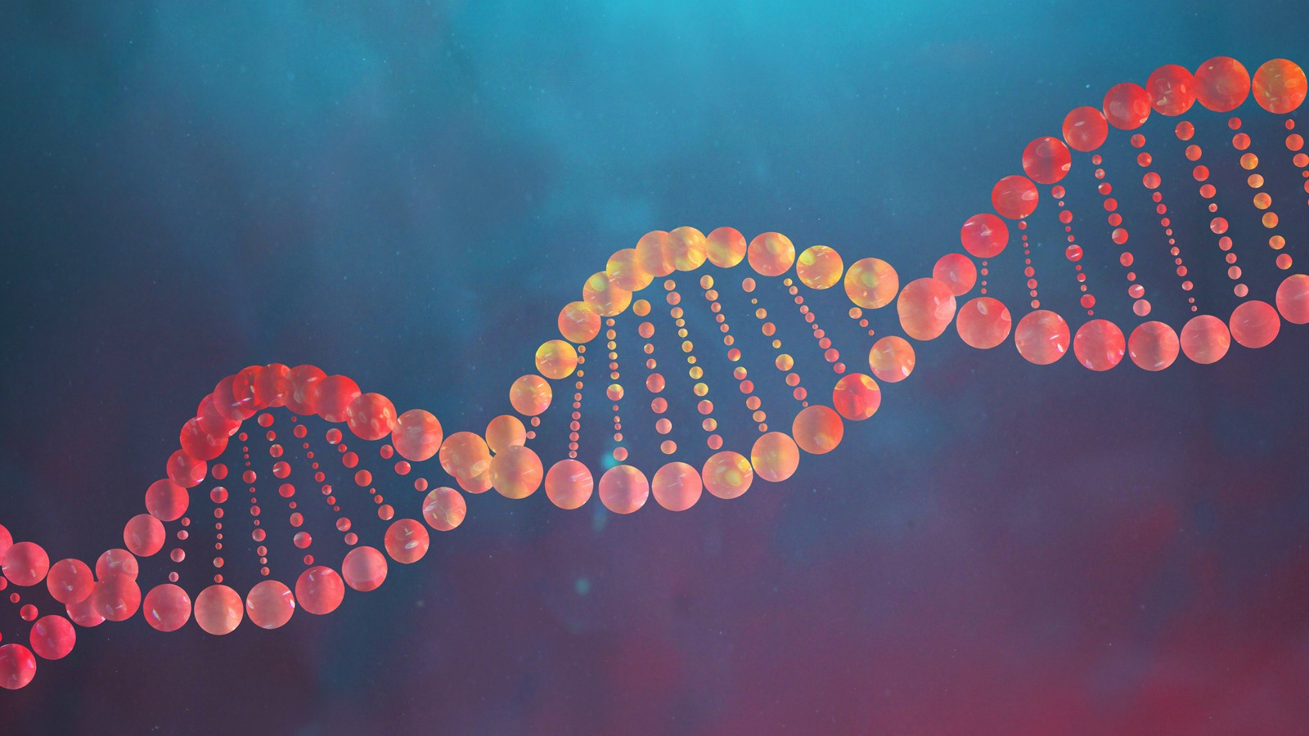
Learning Outcomes
I can explain how DNA, chromatin and chromosomes are linked.
I can explain the difference between genes, traits and alleles.
I can explain what a karyotype is.

Slide 3
Terminology
DNA – genetic information that codes for life (all life)
Genome – complete set of DNA in an organism or population (human genome)

Slide 4
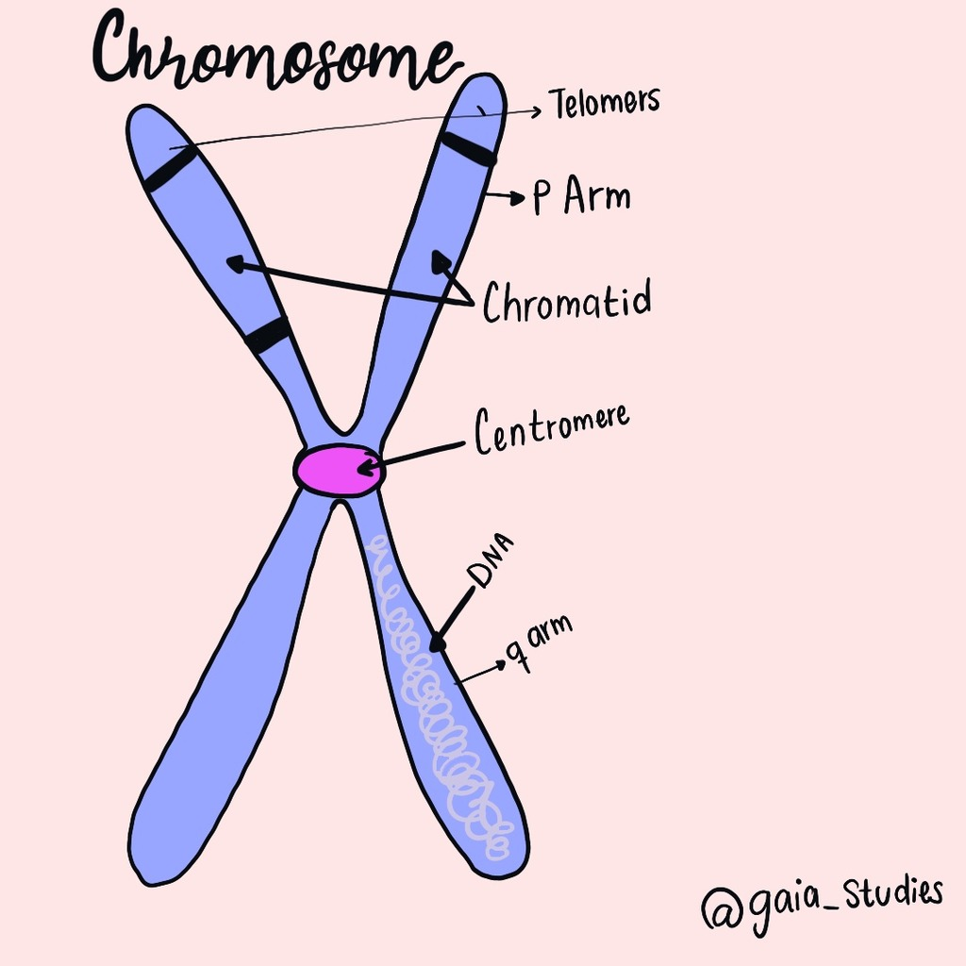
Terminology
Chromosome – strands of DNA (23 pairs in human genome)
Gene – portion of a chromosome that codes for a specific protein (2058 genes on human chromosome 1)
Allele – different version of a gene (PTC paper taste test)

Slide 5
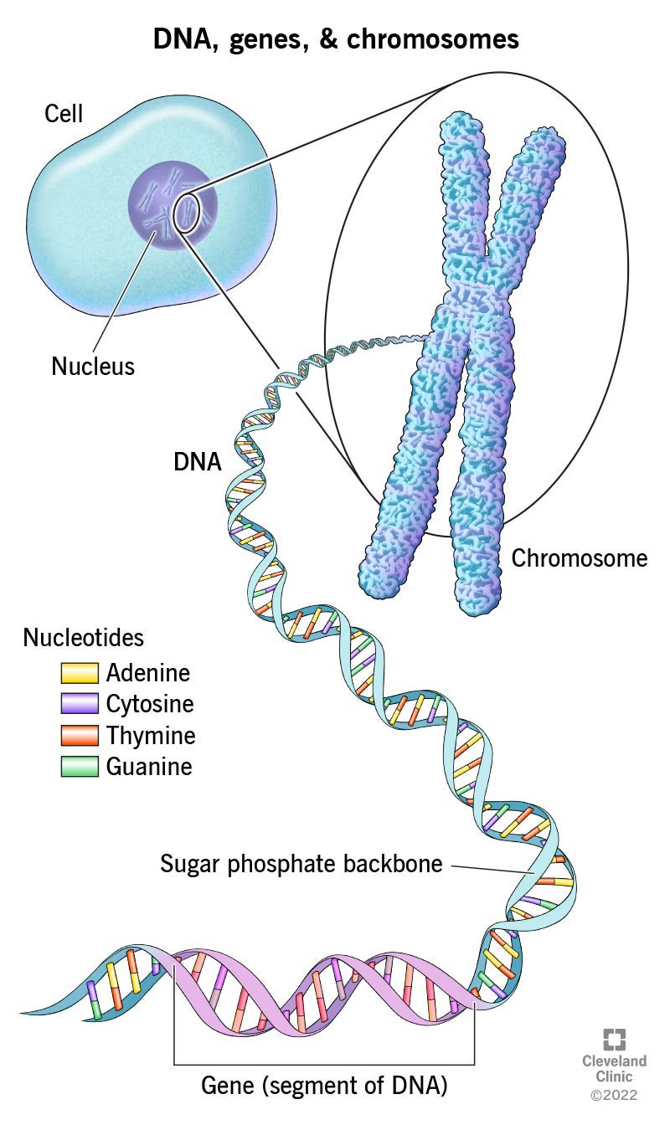
Chromatin and Chromosomes
during normal cell activity (interphase), paired nucleotides form long fibres called chromatin
at the start of mitosis, the chromatin fibres condense to form chromosomes

Slide 6
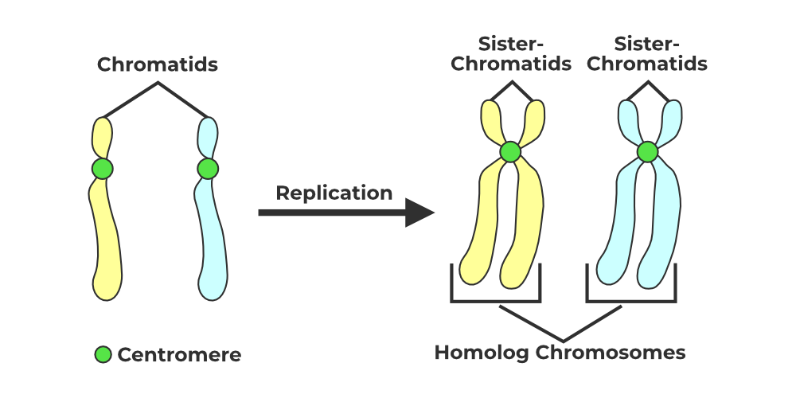
Chromosomes and Chromatin
Human DNA is collected into 46 chromosomes that form 23 chromosomal pairs.
Each pair consists of one chromosome from each parent

Slide 7
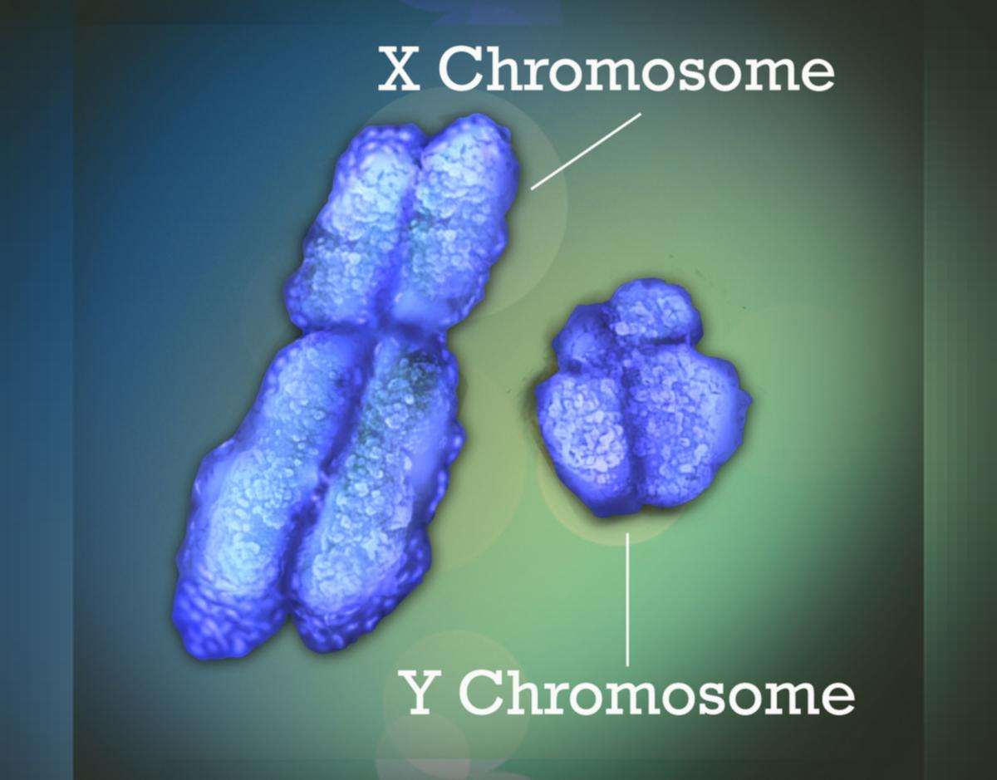
Chromosomes and Chromatin
There are 24 distinct chromosomes in human DNA
22 paired homologous chromosomes
X chromosome – paired in females & only one in males
Y chromosome – single one in males only paired to an X chromosome

Slide 8
Chromosomes and Chromatin
in humans, each of the 22 paired chromosome codes for between 2058 genes (chromosome 1) and 234 genes (chromosome 21)
X chromosome codes for 842 genes
Y chromosome only codes for 71 proteins – results in “sex-linked” traits

Slide 9
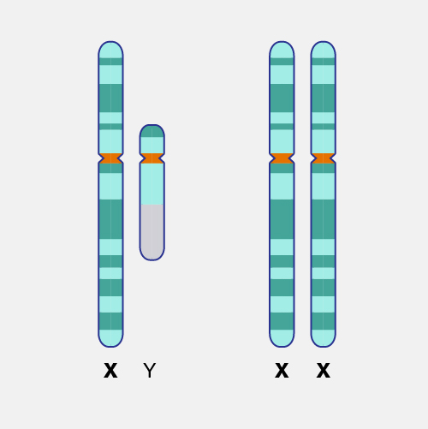
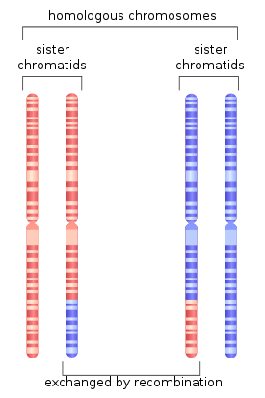
Homologous Chromosomes
homologous chromosomes are pairs of chromosomes that are similar in:
length
centromere position, and
contain gene sequences for the same traits

Slide 10
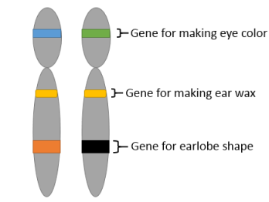
Genes
a gene is a sequence of DNA bases that codes for a specific trait
alleles – variations in a gene that results in differences in individuals

Slide 11
Genes
Autosomal or Mendelian Traits
traits controlled by one gene sequence with only 2 alleles
ex: hair line, hitch-hiker’s thumb, PTC paper

Slide 12
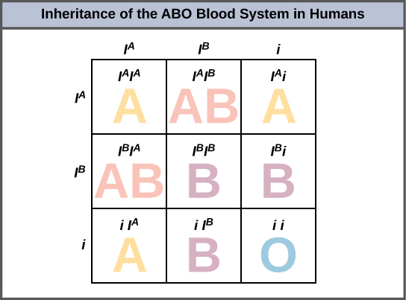
Genes
2. Multiple Allele Traits
traits controlled by one gene sequence with more than 2 alleles
ex: blood type

Slide 13
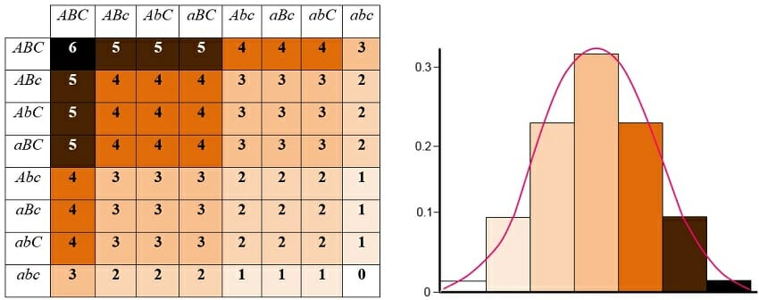
Genes
3. Polygenic Traits
traits controlled by multiple genes sequences
ex: eye colour, hair colour, height

Slide 14
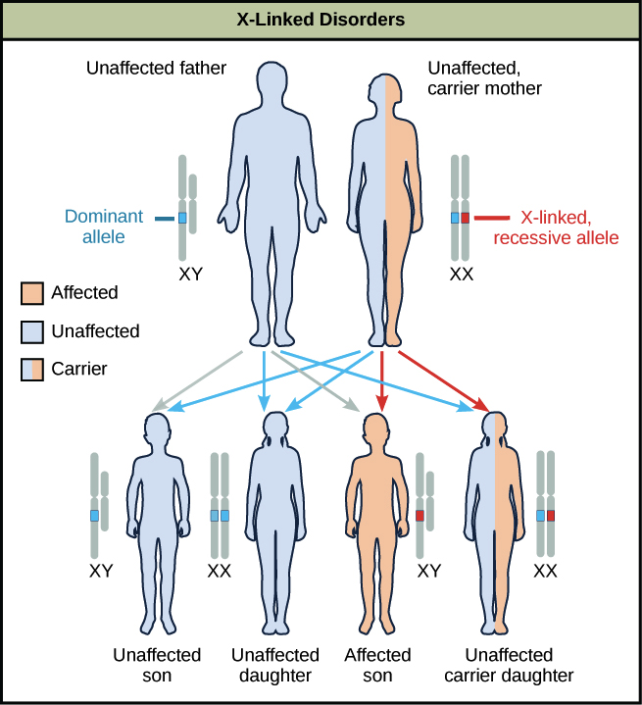
Genes
4. Sex-Linked Traits
traits affected by the presence or absence of the Y chromosome
ex: colour blindness, baldness

Slide 15
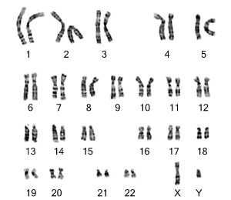
Karyotypes
refers to the number and appearance of paired chromosomes from a eukaryotic cell
often shown as a photograph

Slide 16
Karyotypes

