Slide 1
DNA
Science 10

Slide 2
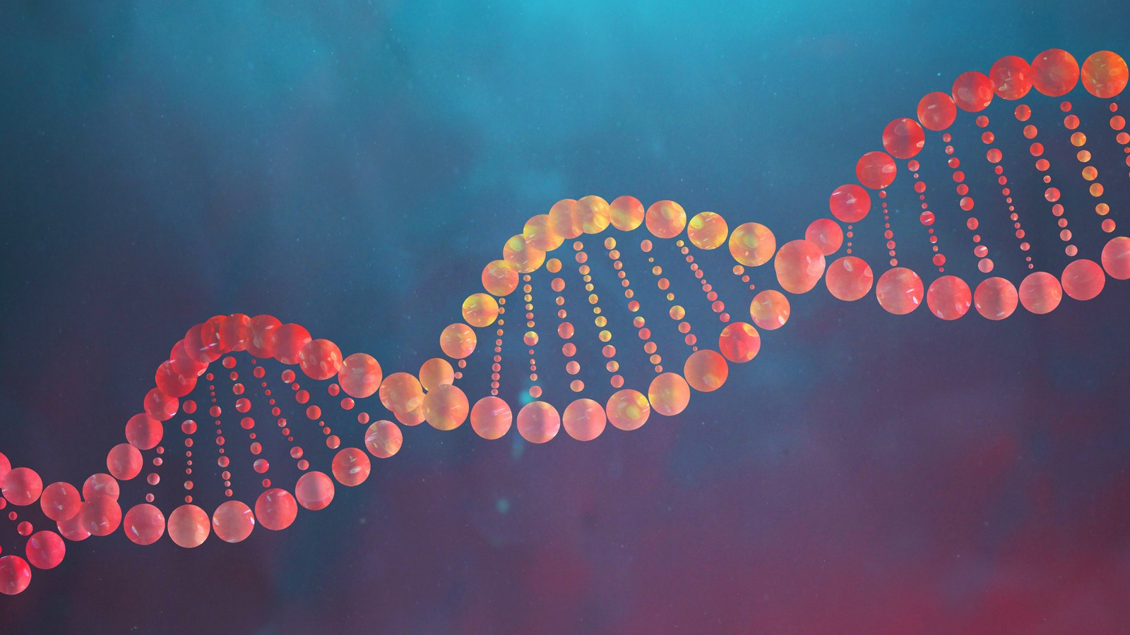
Learning Outcome
I can describe the basic structure and function of DNA.

Slide 3
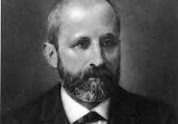
Structure
first observed in 1869 by the German biochemist Frederich Miescher
did not realize the importance of the molecule he had found

Slide 4
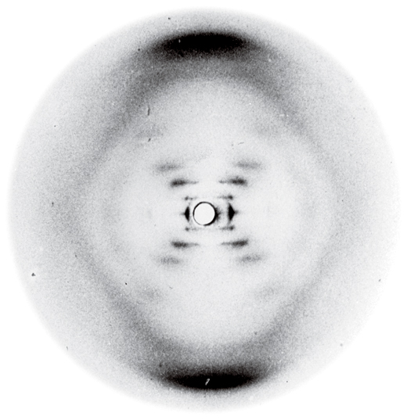
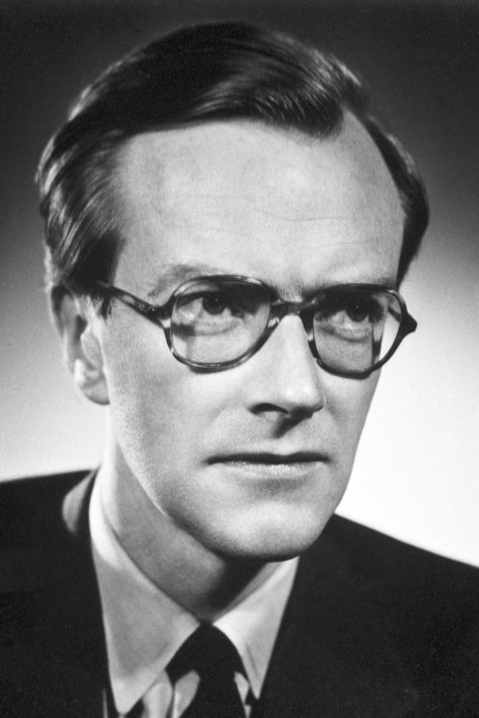
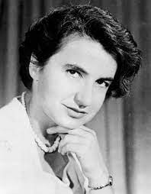
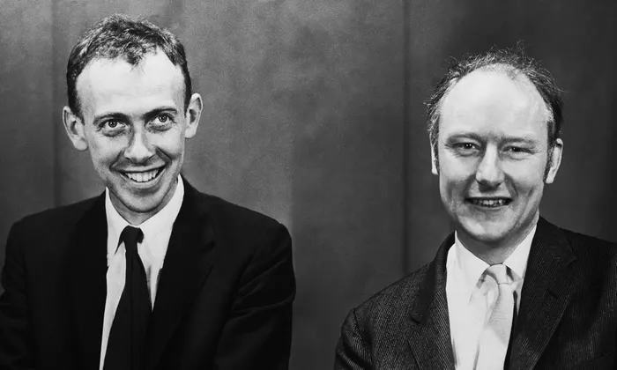
Discovery of the structure of structure of DNA:
Maurice Wilkins (1950) – first used X-ray diffraction on ram sperm to try to discover the shape of DNA
Rosalind Franklin (1952) – extended the work of Wilkins to produce a higher quality X-ray diffraction image
James Watson & Francis Crick (1953) – used the information from Wilkins and Franklin to hypothesize a correct model of the shape of DNA

Slide 5
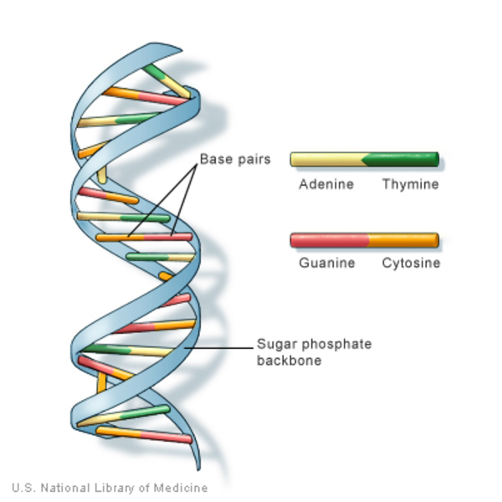
Structure
Looks like a twisted ladder → called a double helix
Sugar and phosphate groups make up the “sides” of the ladder
Nitrogenous bases make up the steps/rungs

Slide 6
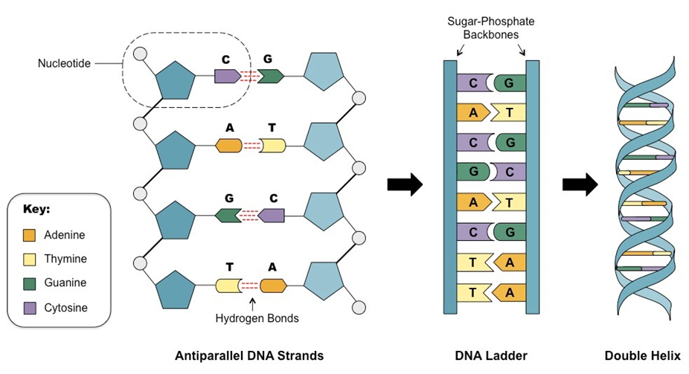
Structure
1 sugar, 1 phosphate group and 1 nitrogenous base is called a nucleotide

Slide 7
Structure
Example: Strand 1 A T A A C G T C A
(Complementary Strand) Strand 2
Human DNA is composed of around 3 billion nucleotides on 46 chromosomes

Slide 9
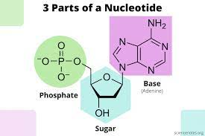
DNA Function
DNA codes for the blueprints of life → it is an information molecule
each nucleotide is a DNA monomer
a sequence of nucleotide monomers is a DNA polymer
each DNA polymer codes for a specific protein or other gene

Slide 10
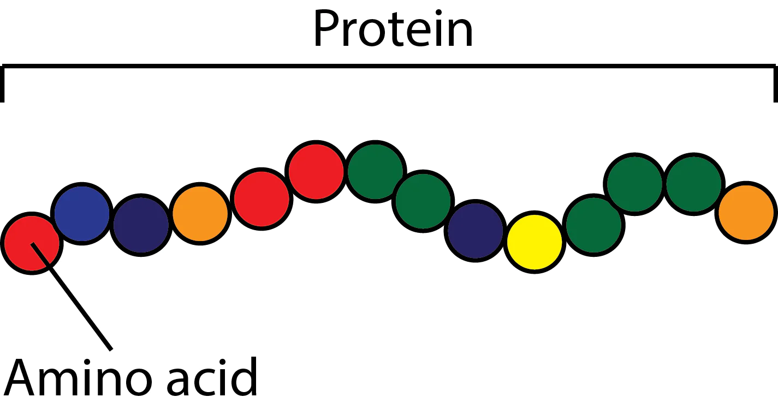
DNA Function
each DNA polymer is divided into a 3-nucleotide subsection called a codon
each codon translates into an amino acid
a chain of amino acids forms a protein

Slide 11
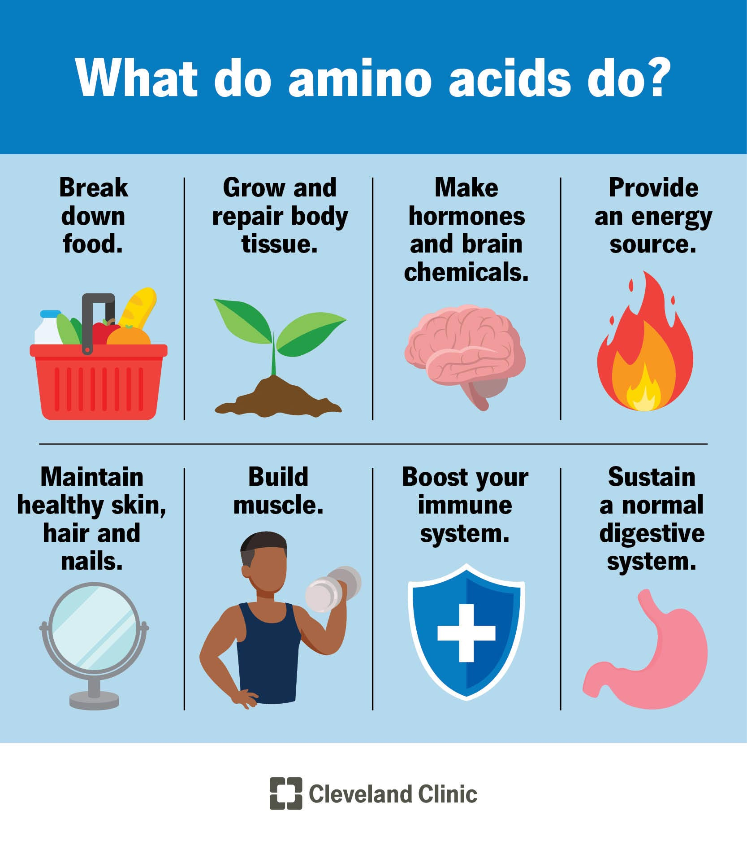
DNA Function
there are approximately 20,000 protein-coding genes and another 5,000 other genes in human DNA
these may vary slightly between individuals → results in differences between individuals
proteins form the enzymes, structural molecules, hormones, etc. that allow for life

Slide 12
DNA Activity
Build and Pair a DNA Strand
1. Students will each randomly pick one strand of DNA.
2. Students will build their DNA sequence out of coloured mini marshmallows, toothpicks and a piece of licorice (or other types of candy).
3. Once built, students will need to compare their DNA strand against other students’ DNA to find the opposite matching half of DNA.
4. When a match has been found, students will call the teacher over to verify their match.
5. Once verified, students can eat their half of DNA.

